Slide 1
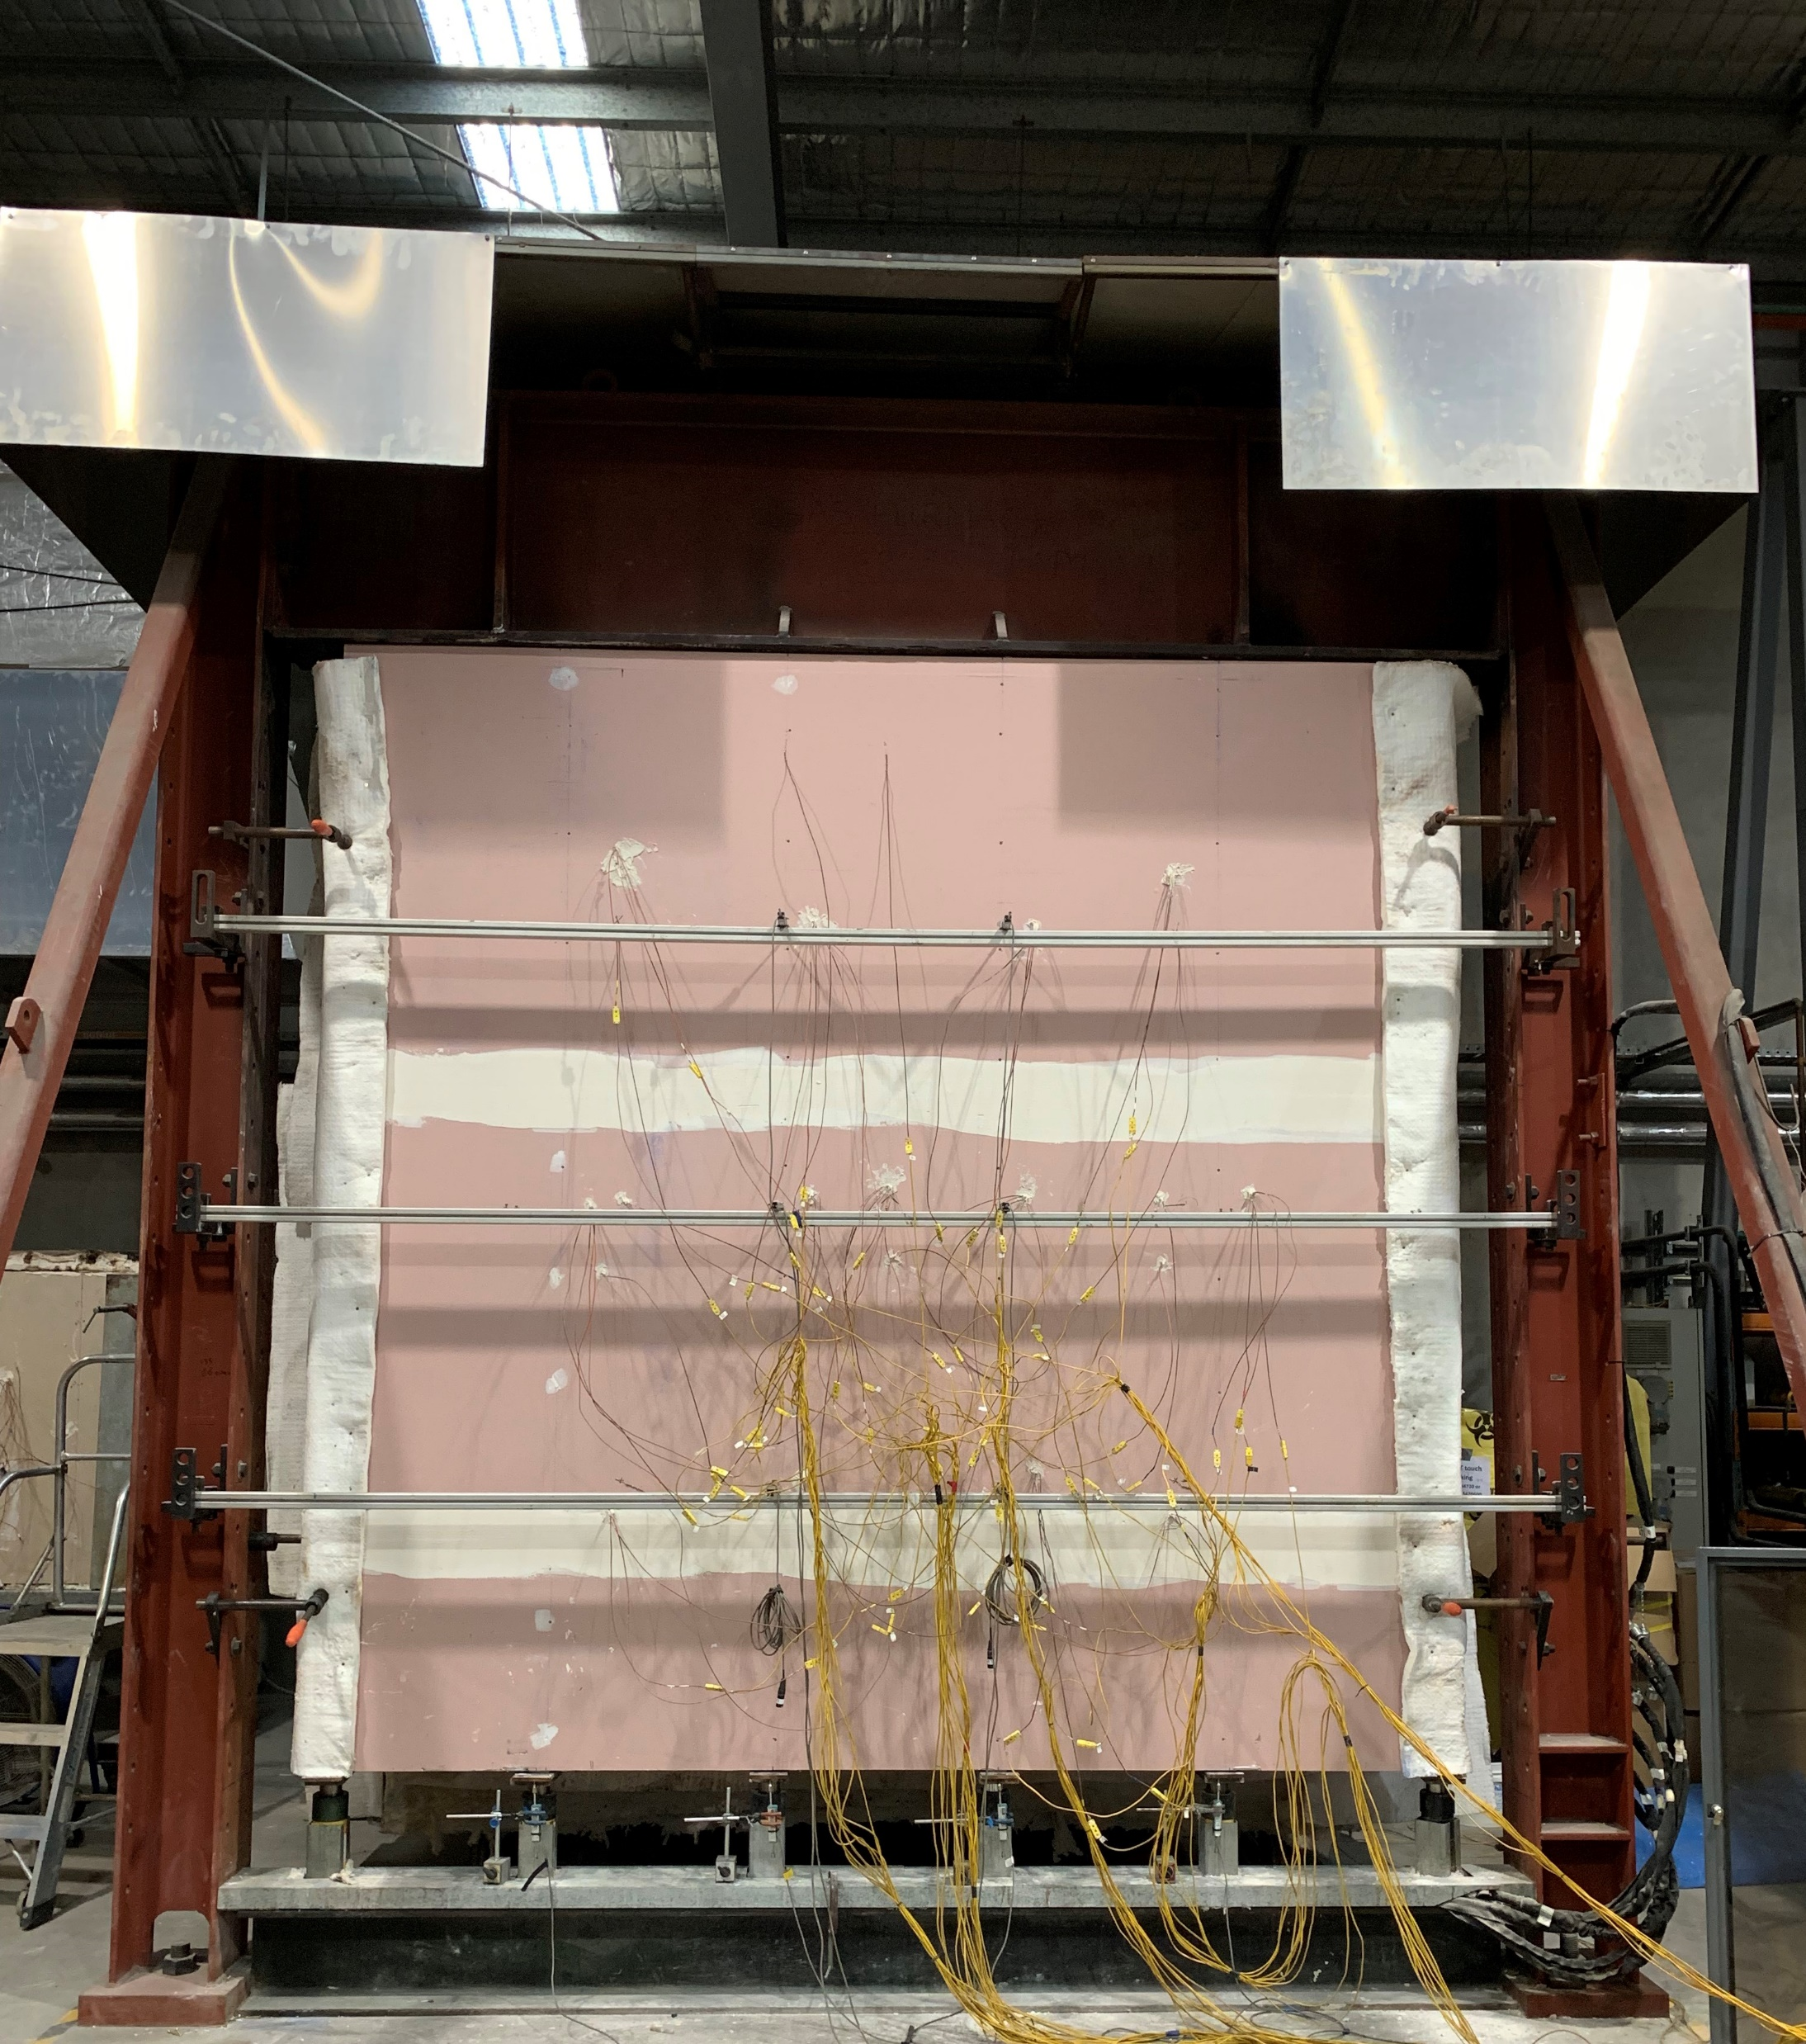
Top Beam (WB)
Plasterboard Joints
Insulated Sides
Lateral LVDT
UC
UC
Rams and Loading Plates
Thermocouples
Bottom Beam (UB)
Axial LVDT
Notes:
Typical test setup

Slide 2
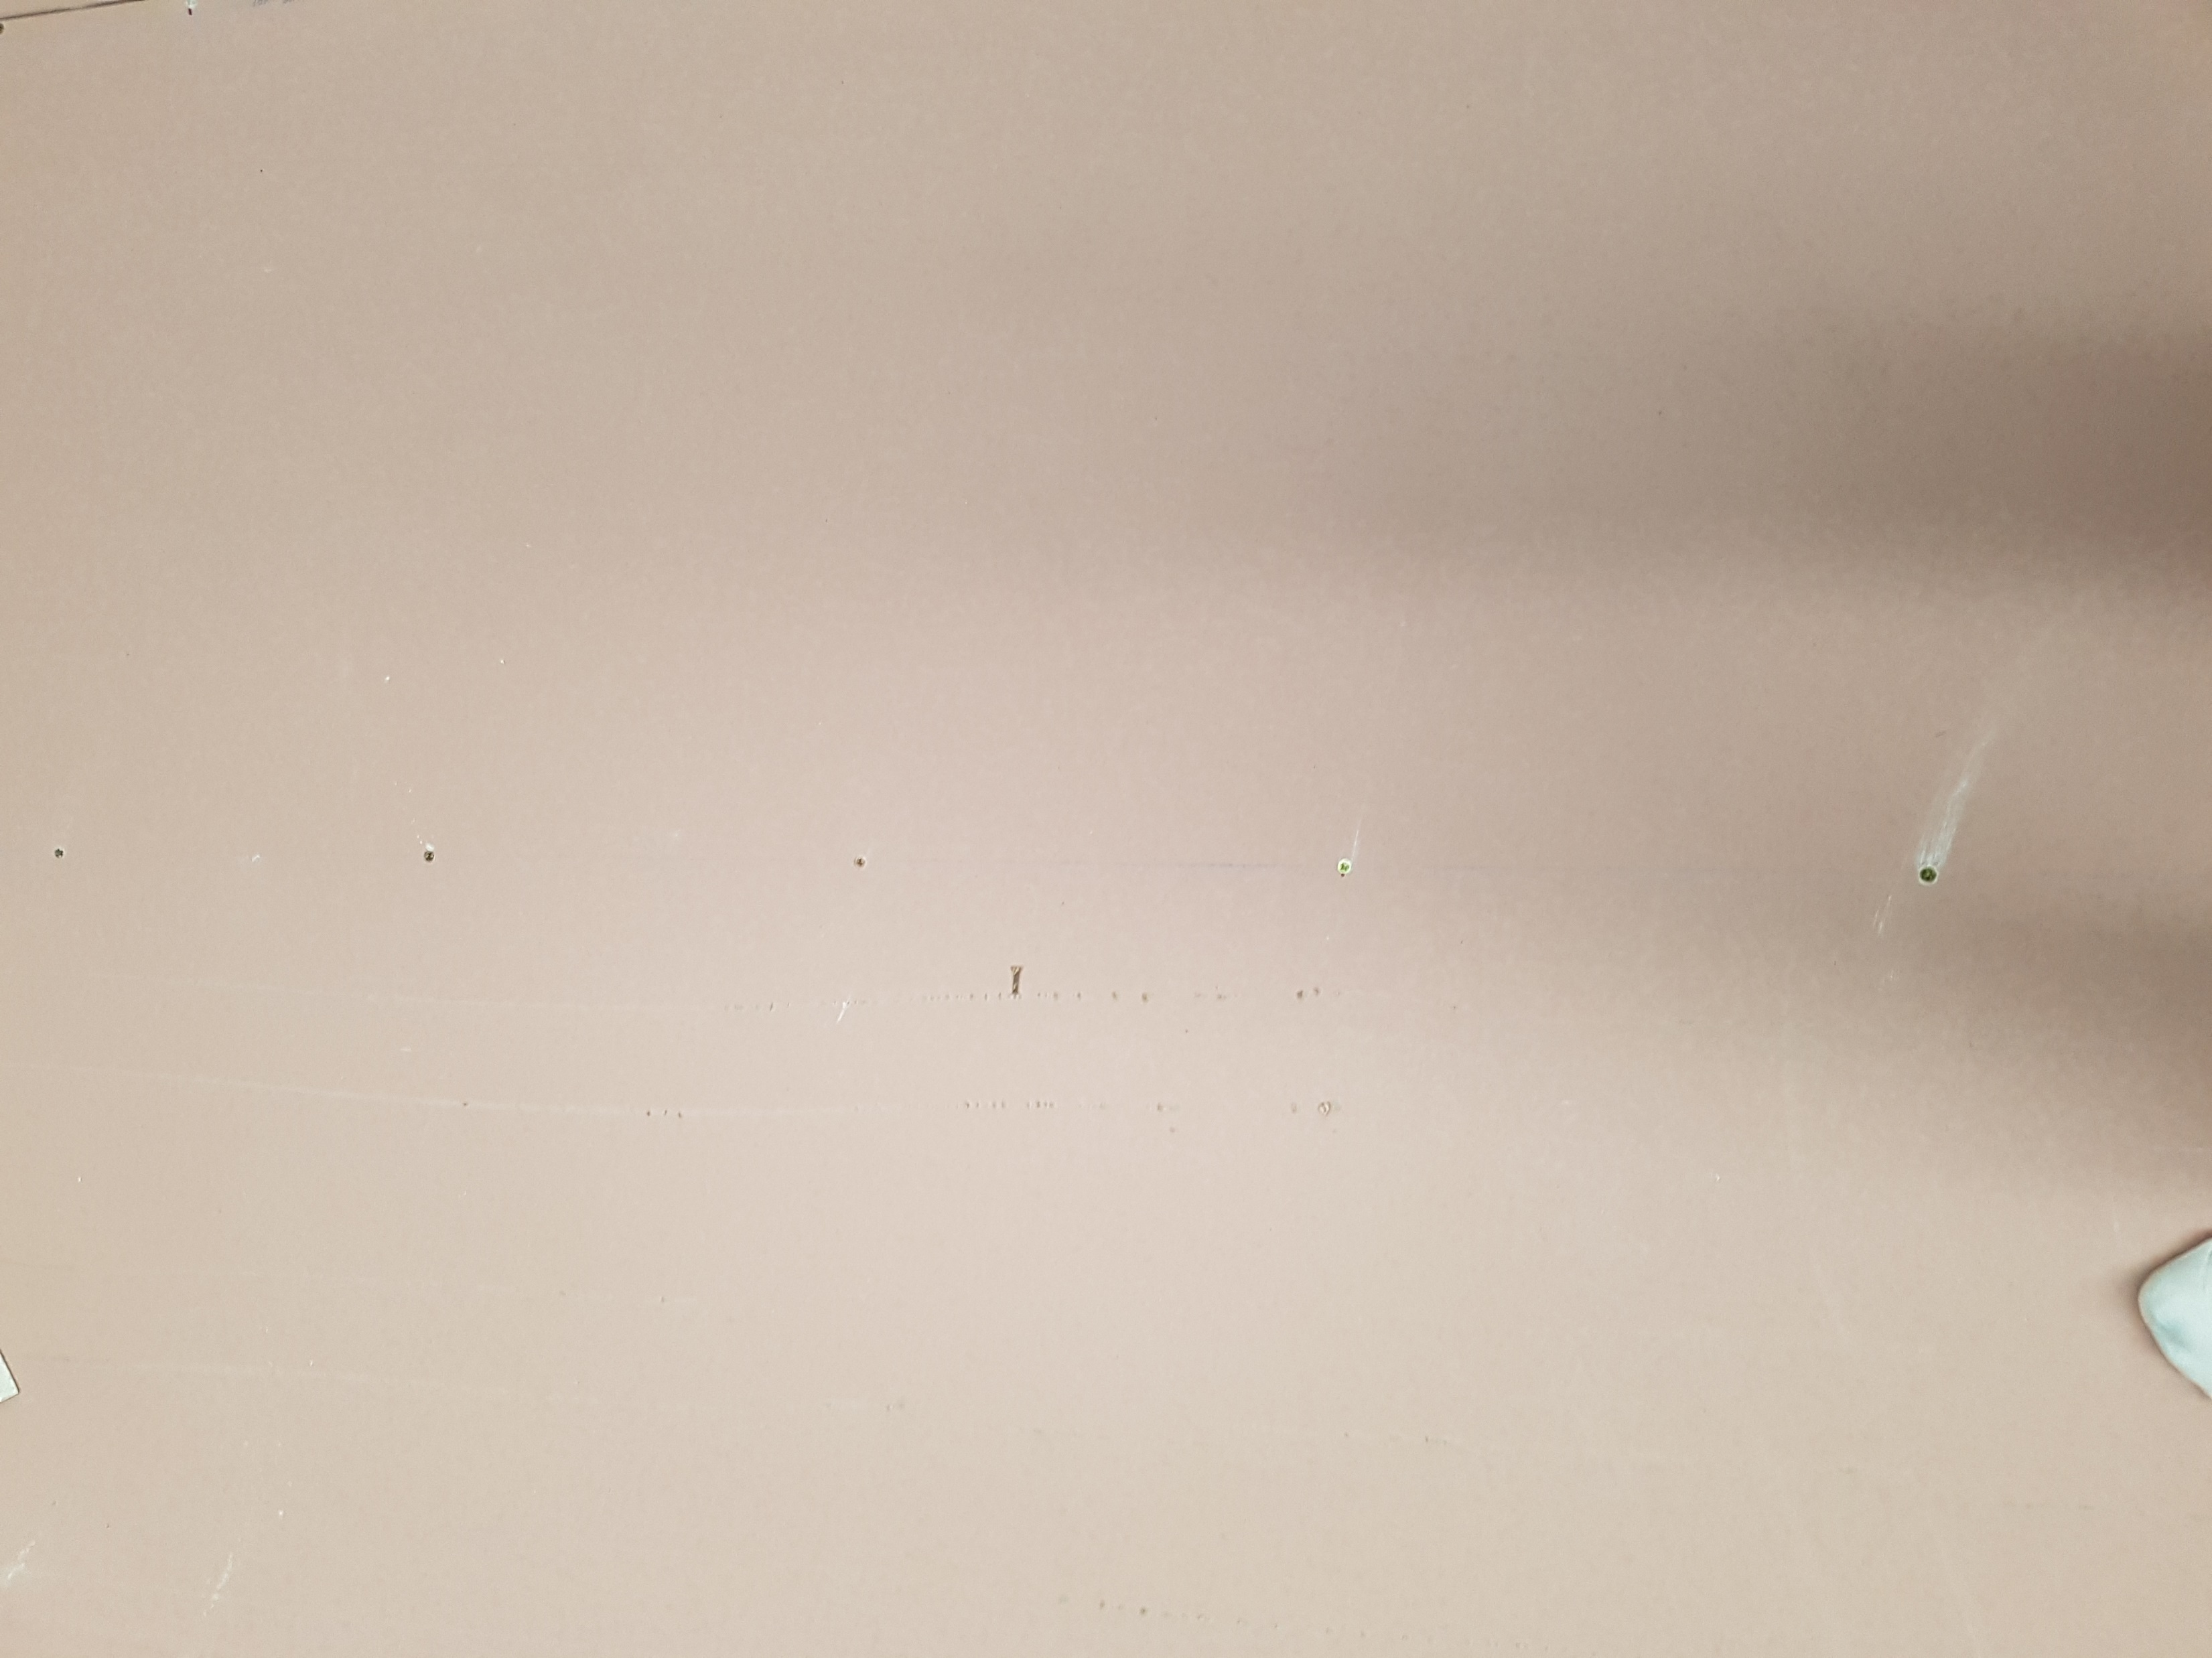
Screw arrangement on the stud without plasterboard joint
300 mm
Notes:
Linear_screw

Slide 3
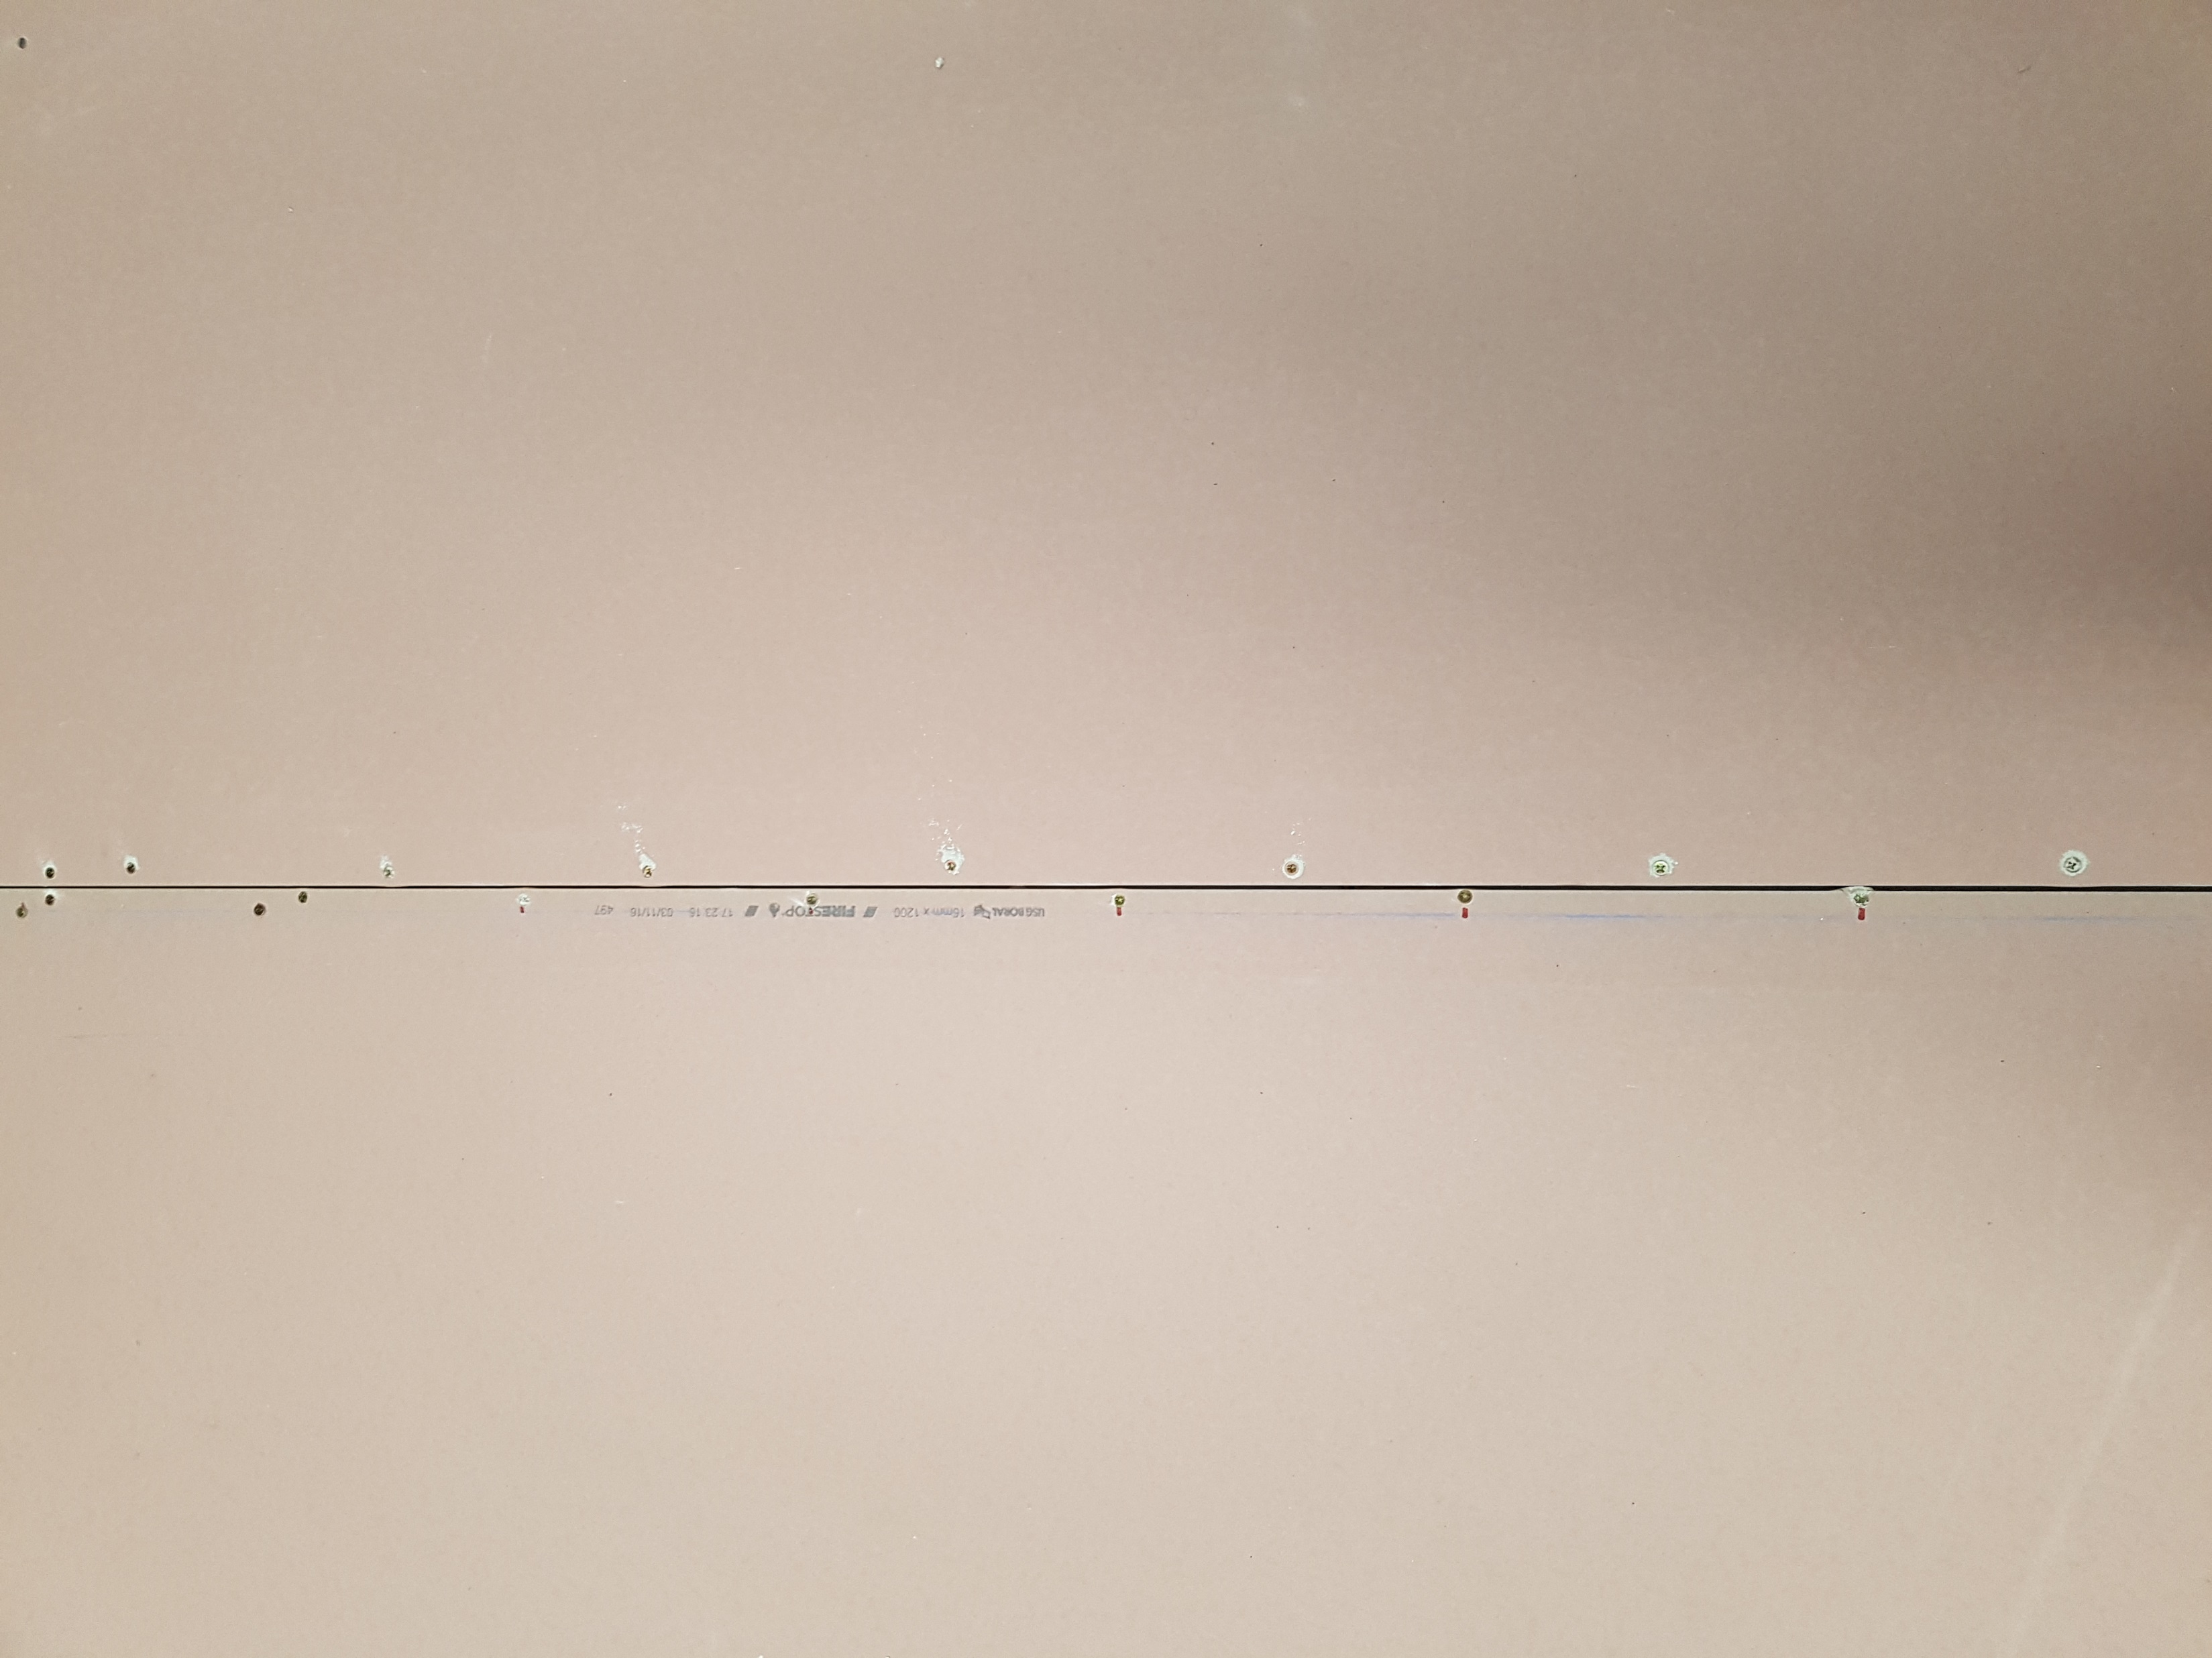
Staggered screw arrangement along the plasterboard joints
200 mm
Notes:
Staggered screw arrangement

Slide 4
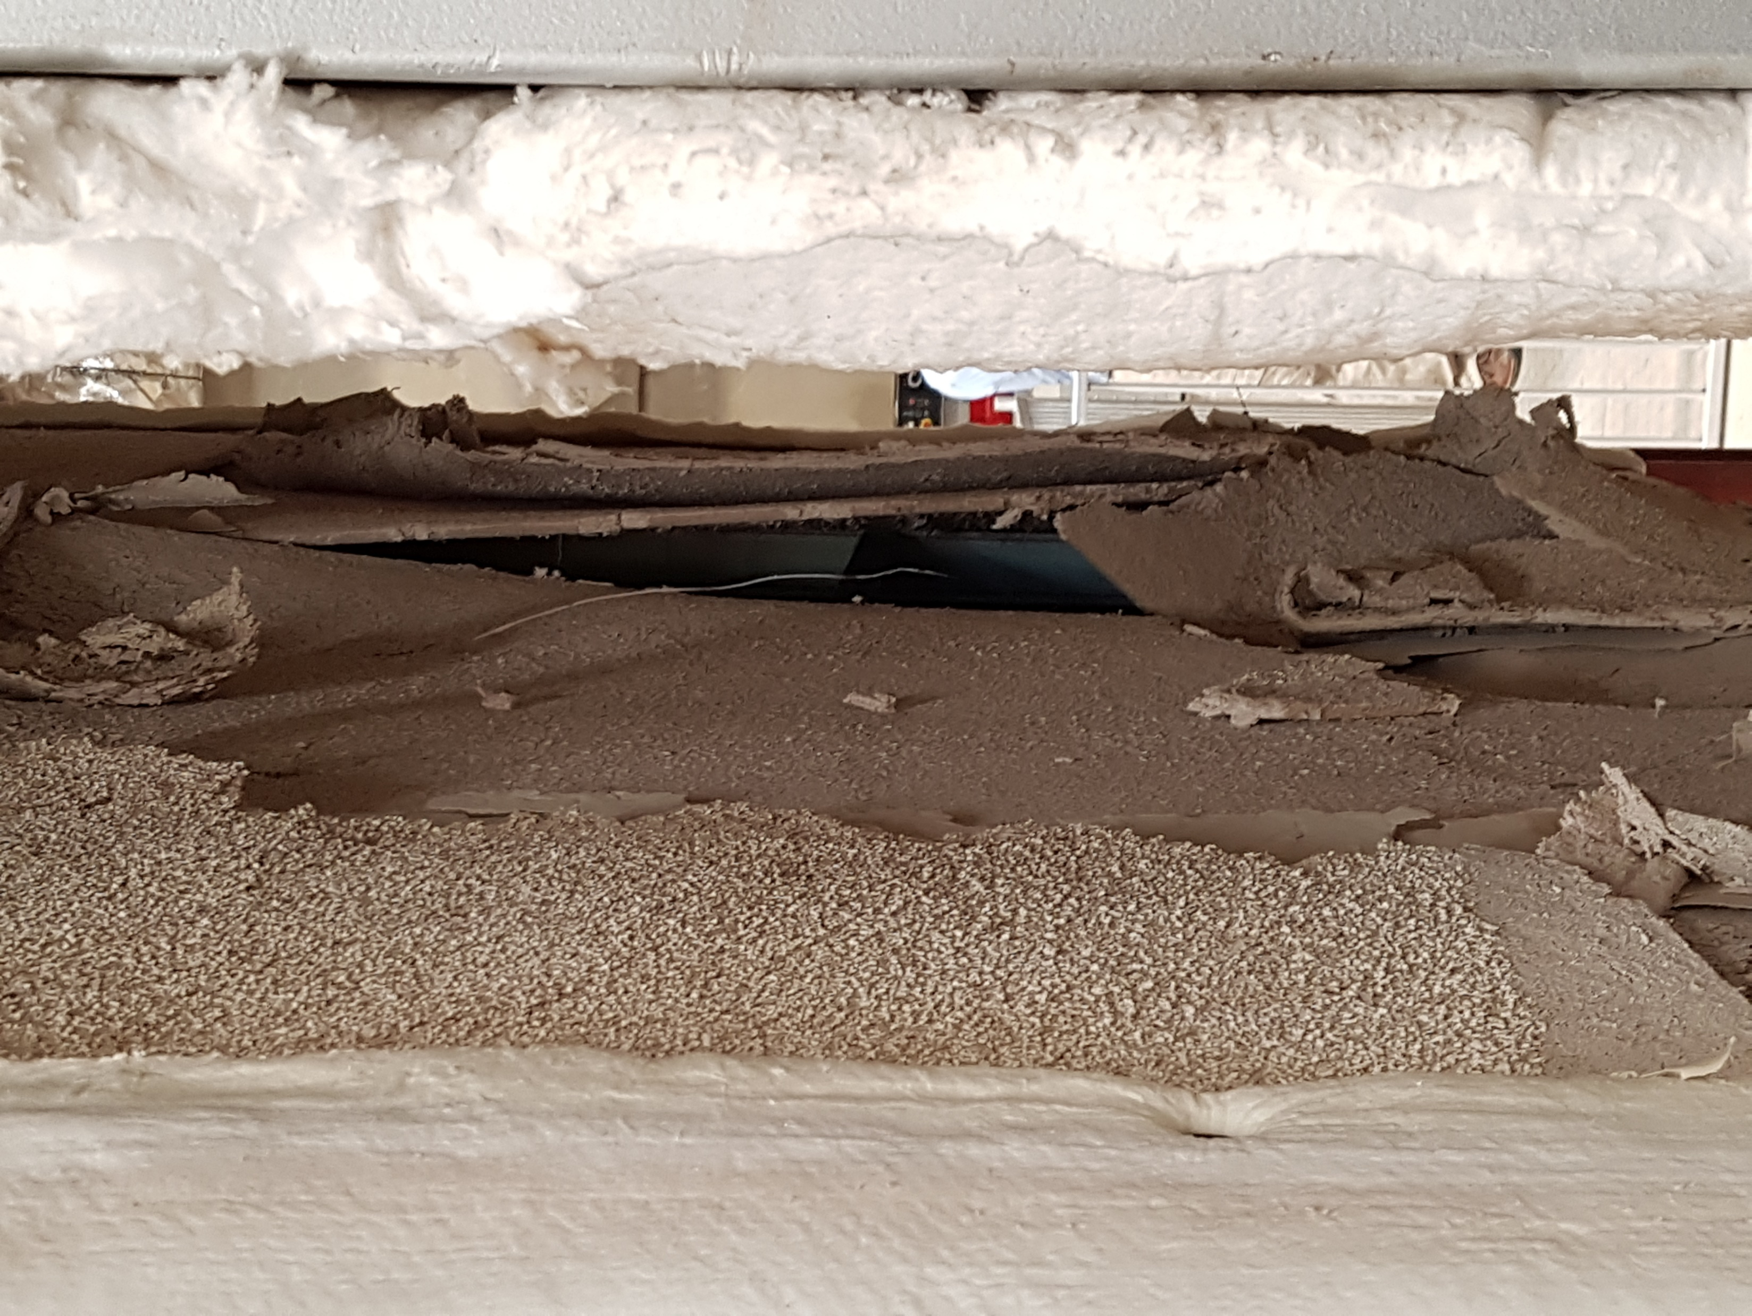
Fire side plasterboard (Pb1)
open-up
Notes:
T1-fireside

Slide 5
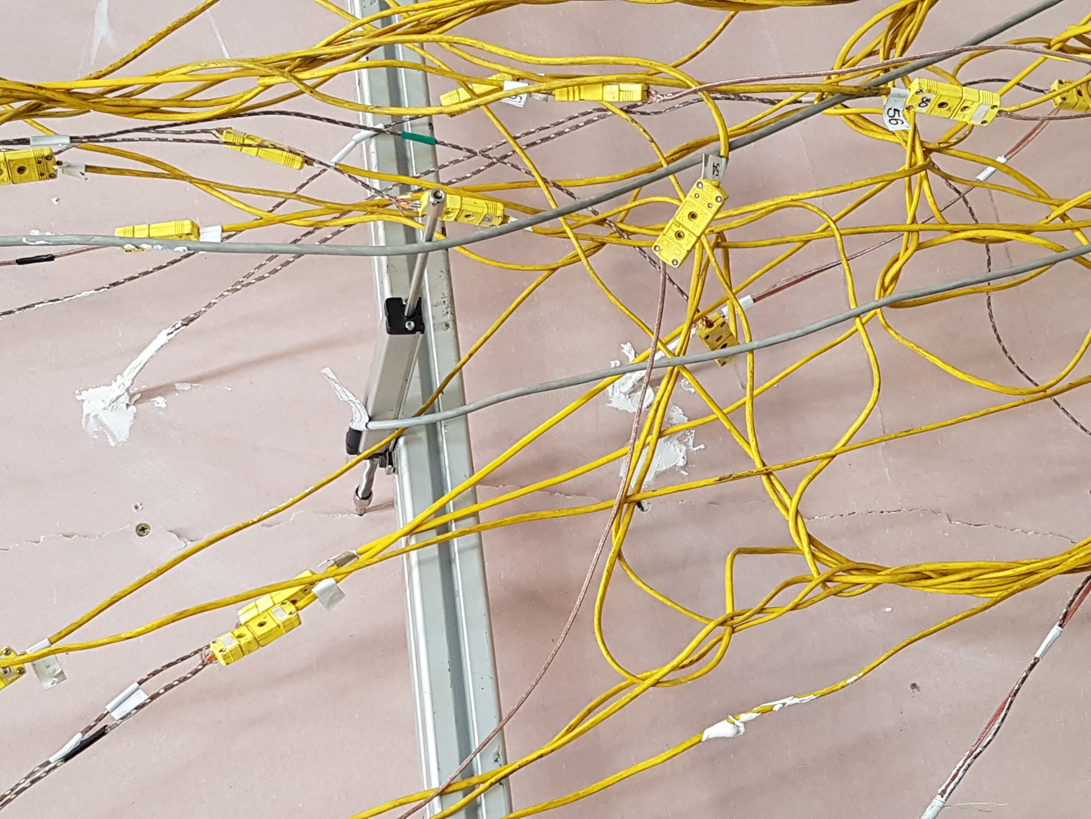
Crack on ambient side plasterboard (Pb4)
Notes:
T1-ambientside

Slide 6
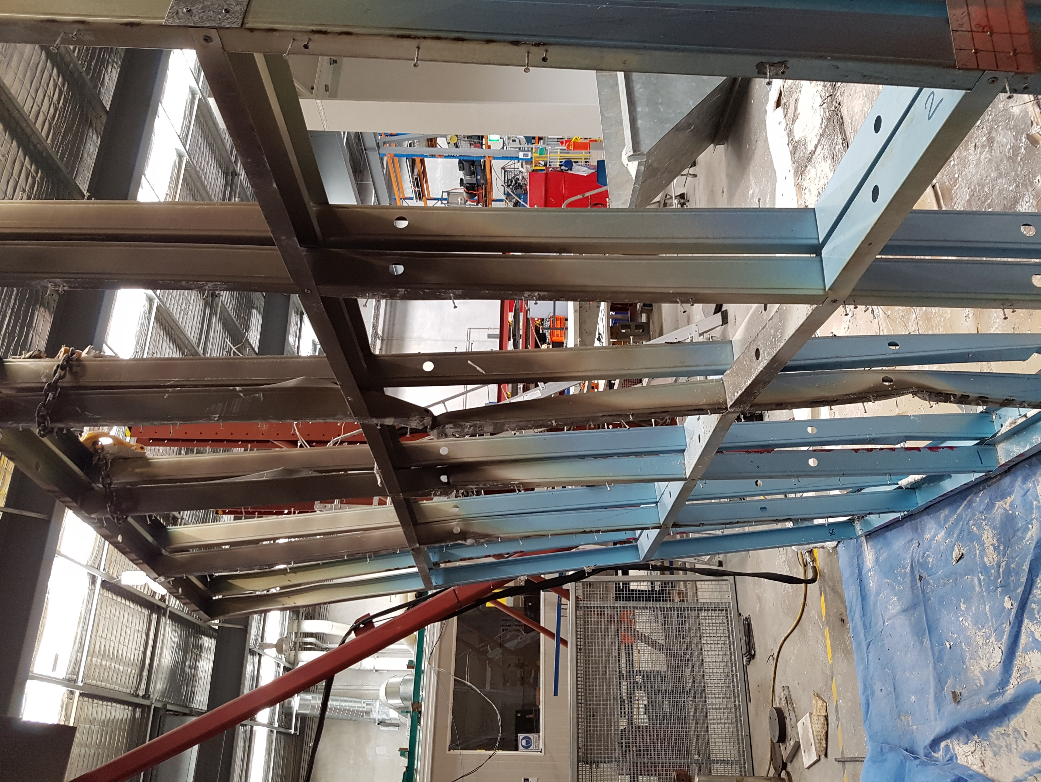
Ambient side
Fire side
Buckling of Stud3

Slide 7
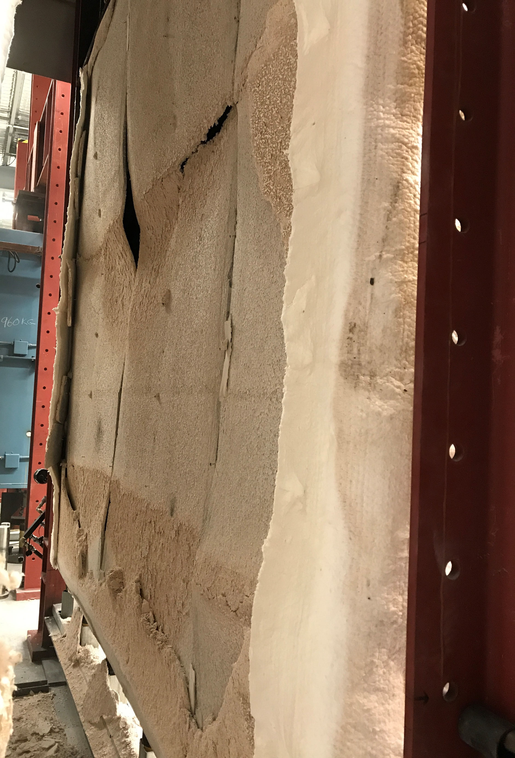
Fire side plasterboard (Pb1)
open-up
Fire side plasterboard (Pb1)
fall-off
Notes:
T2-fireside

Slide 8
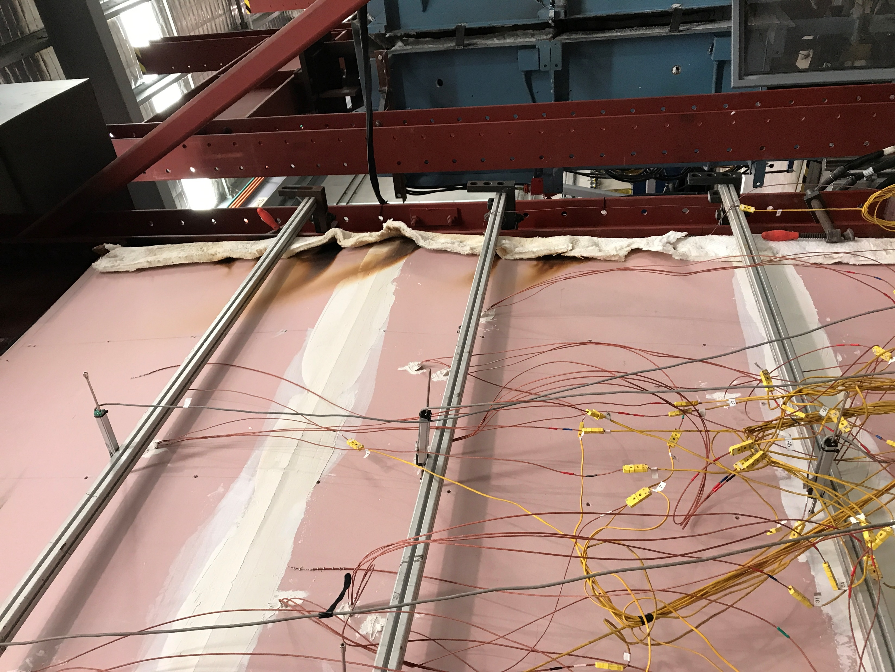
Discolouration of ambient side plasterboard Pb4
Smoke patches on ambient side plasterboard (Pb4)
Notes:
T2-ambientside

Slide 9
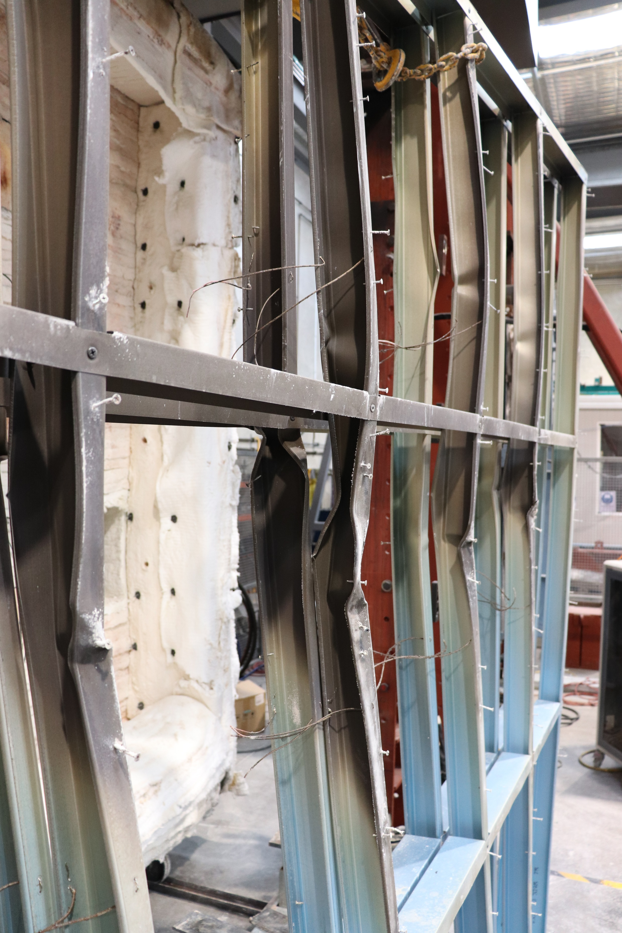
Ambient side
Fire side
Buckling of Stud4
Buckling of Stud5
Notes:
T2-buckling

Slide 10
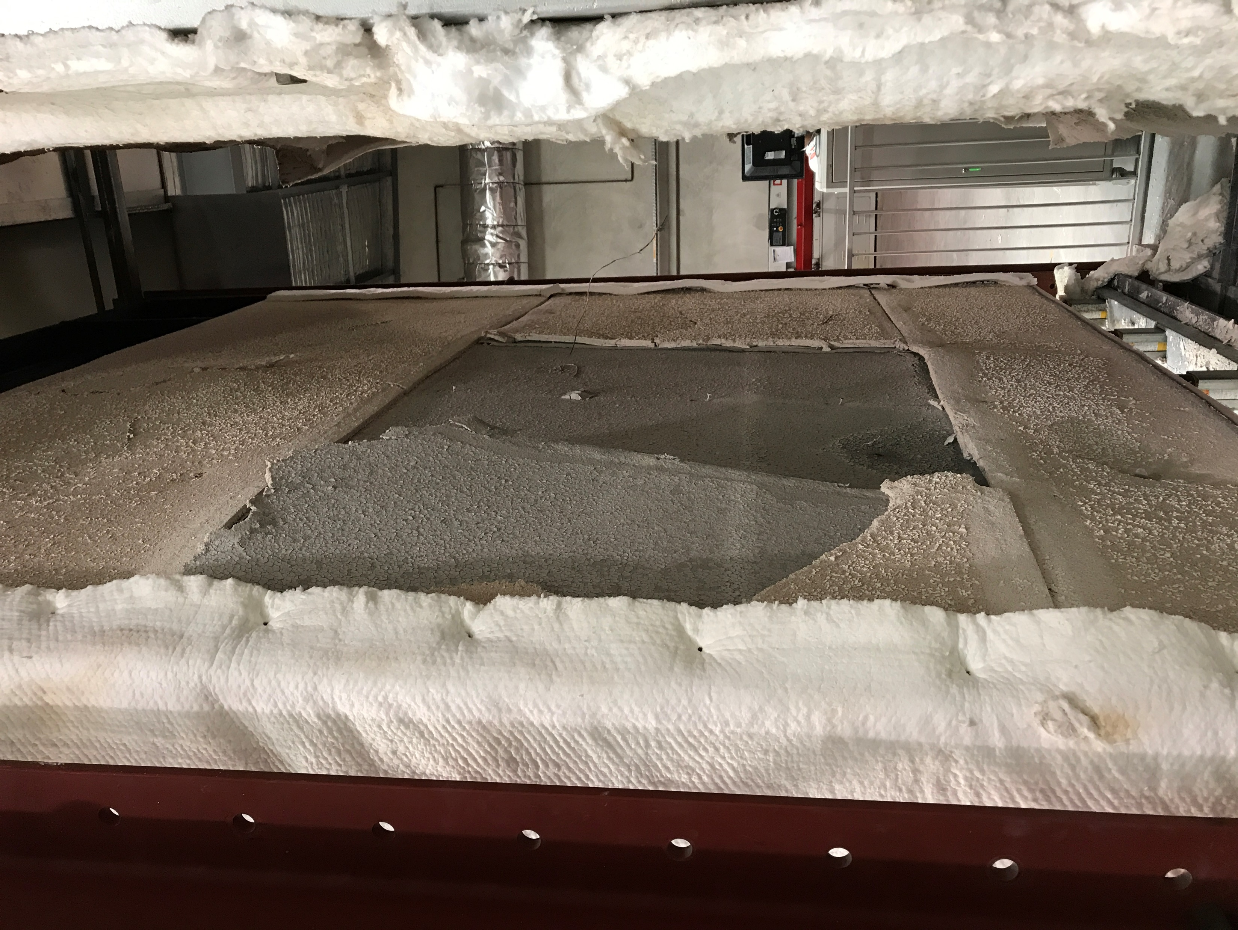
Partial fire side plasterboard (Pb1)
fall-off
Notes:
T3-fireside

Slide 11
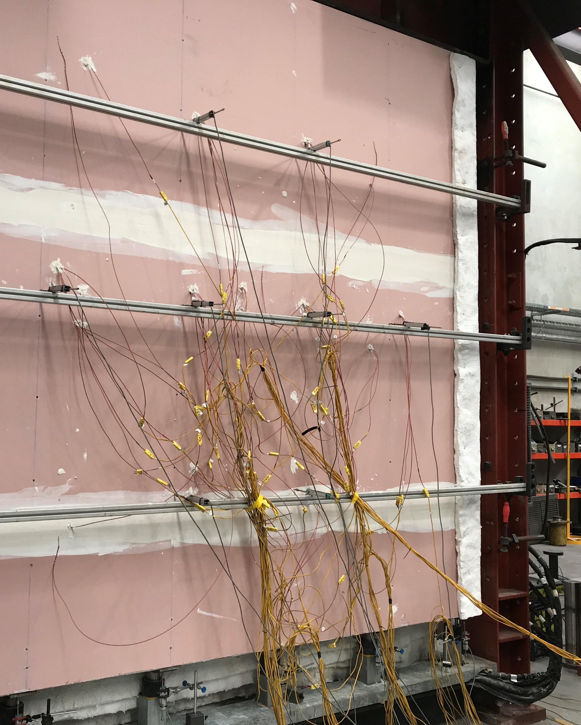
No significant failure on ambient side plasterboard (Pb4)
Notes:
T3-ambientside

Slide 12
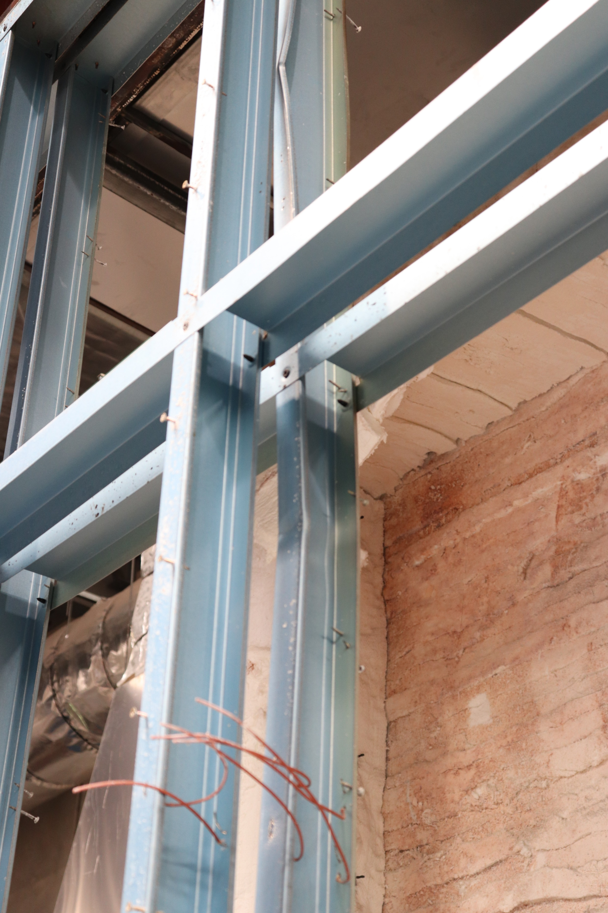
Buckling of Stud3
Ambient side
Fire side
Notes:
T3-buckling

Slide 13
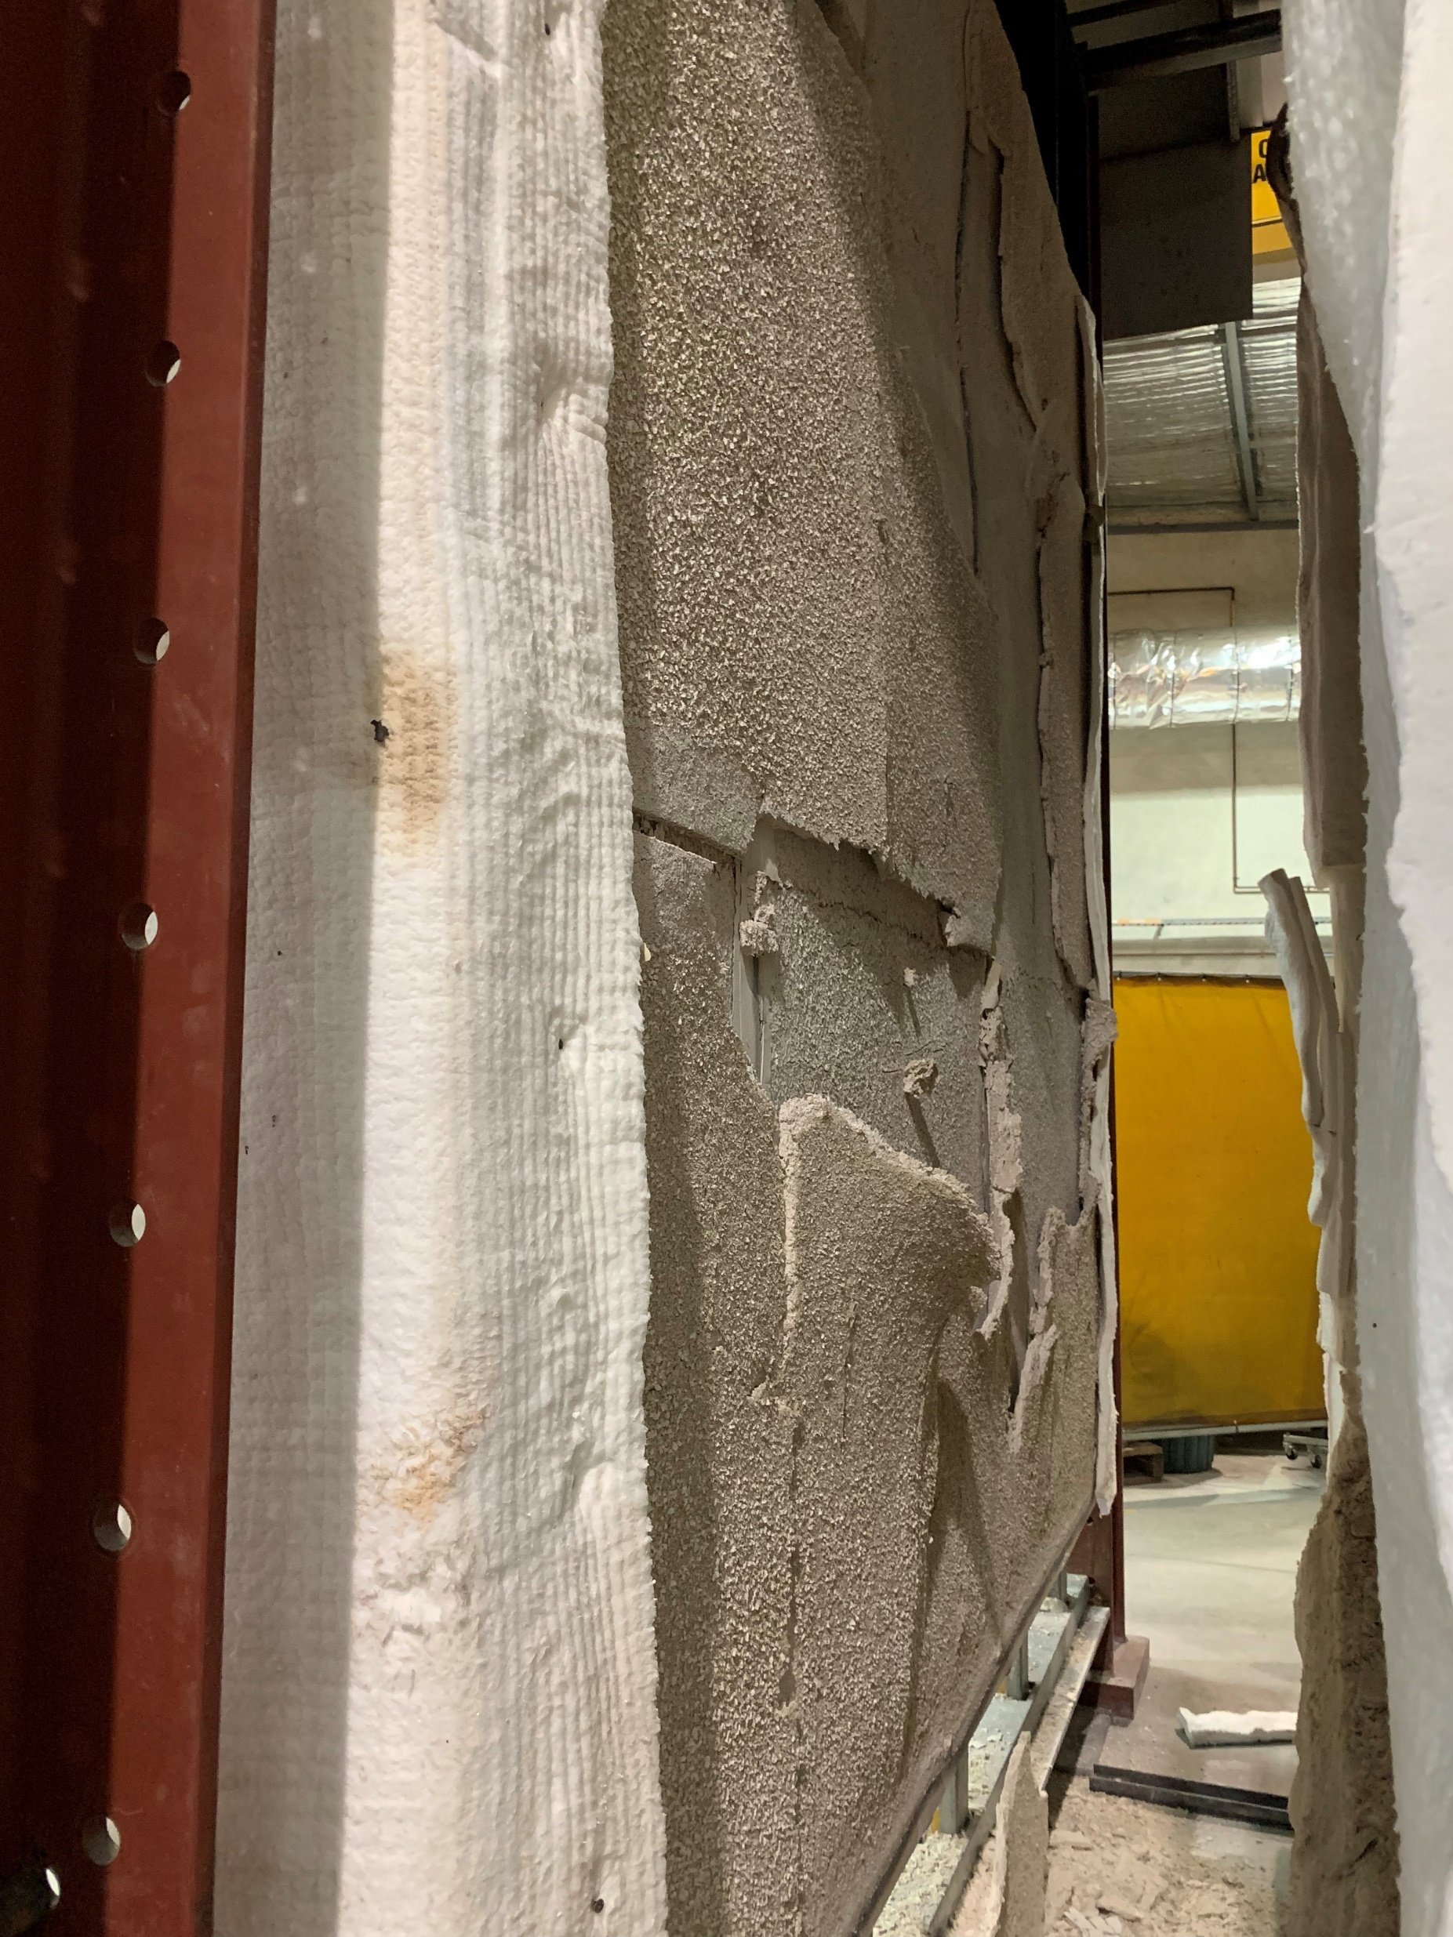
Fire side plasterboard (Pb1)
open-up
Fire side plasterboard (Pb1)
fall-off
Notes:
T4-fireside

Slide 14
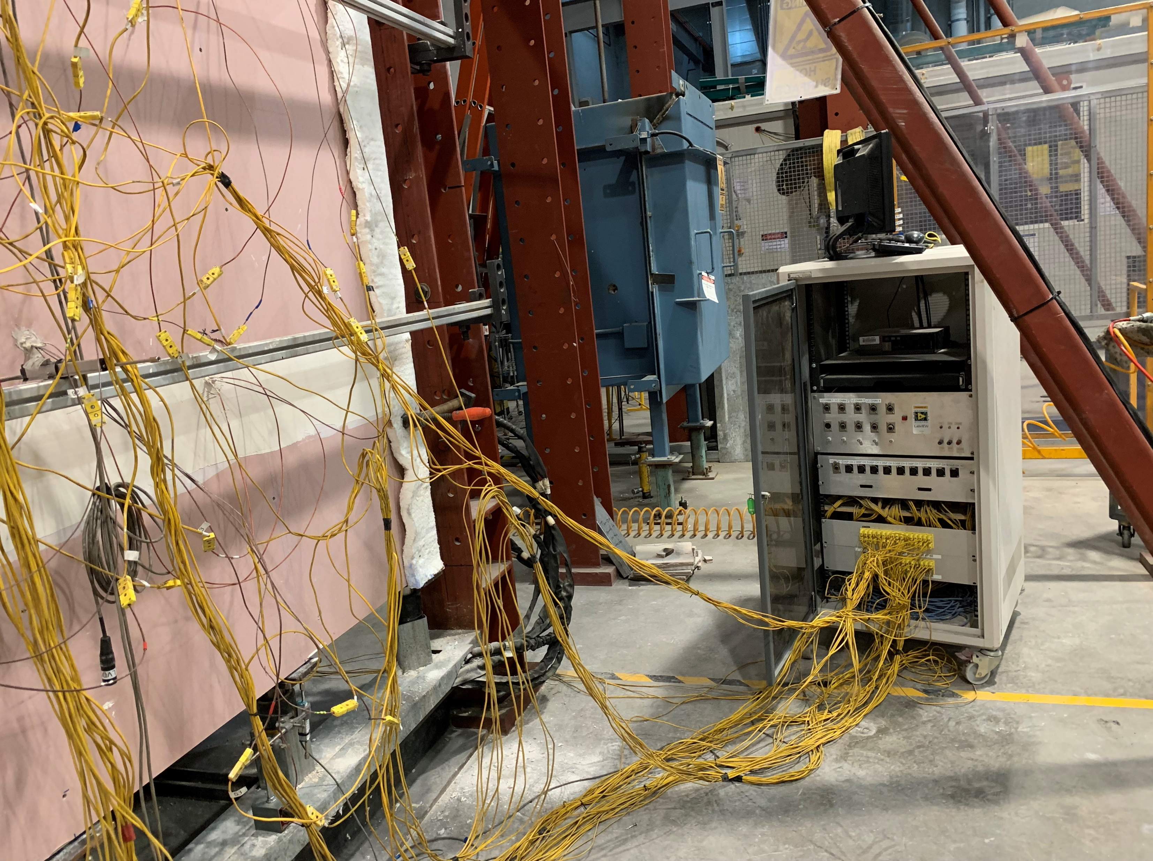
No significant failure on ambient side plasterboard (Pb4)
Notes:
T4-ambientside

Slide 15
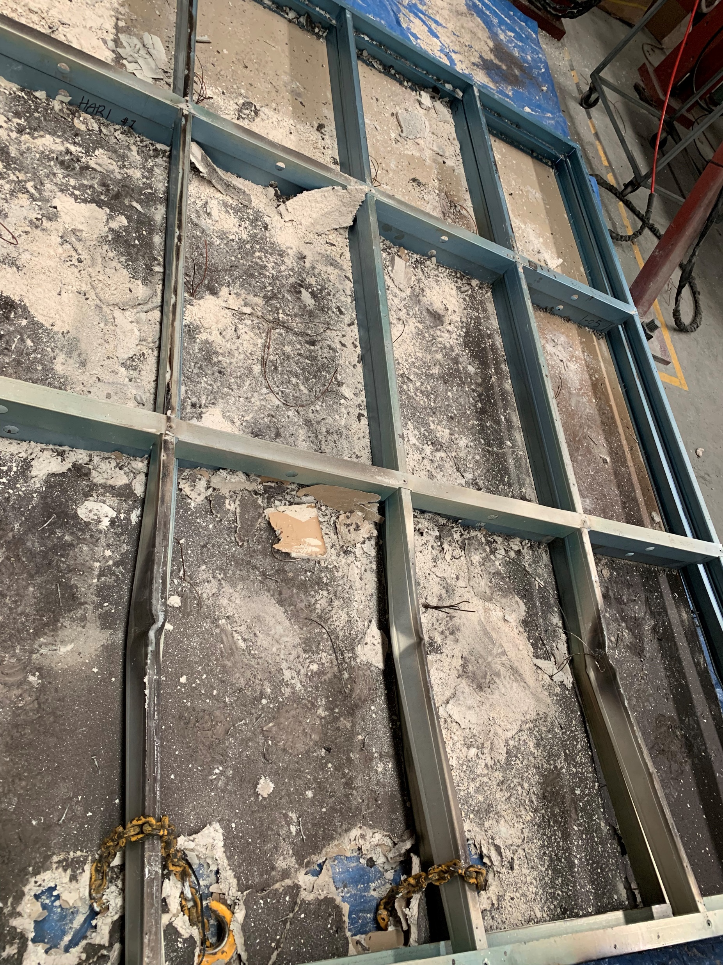
Buckling of Stud2
Buckling of Stud3
Buckling of Stud4
Notes:
T4-buckling

Slide 16
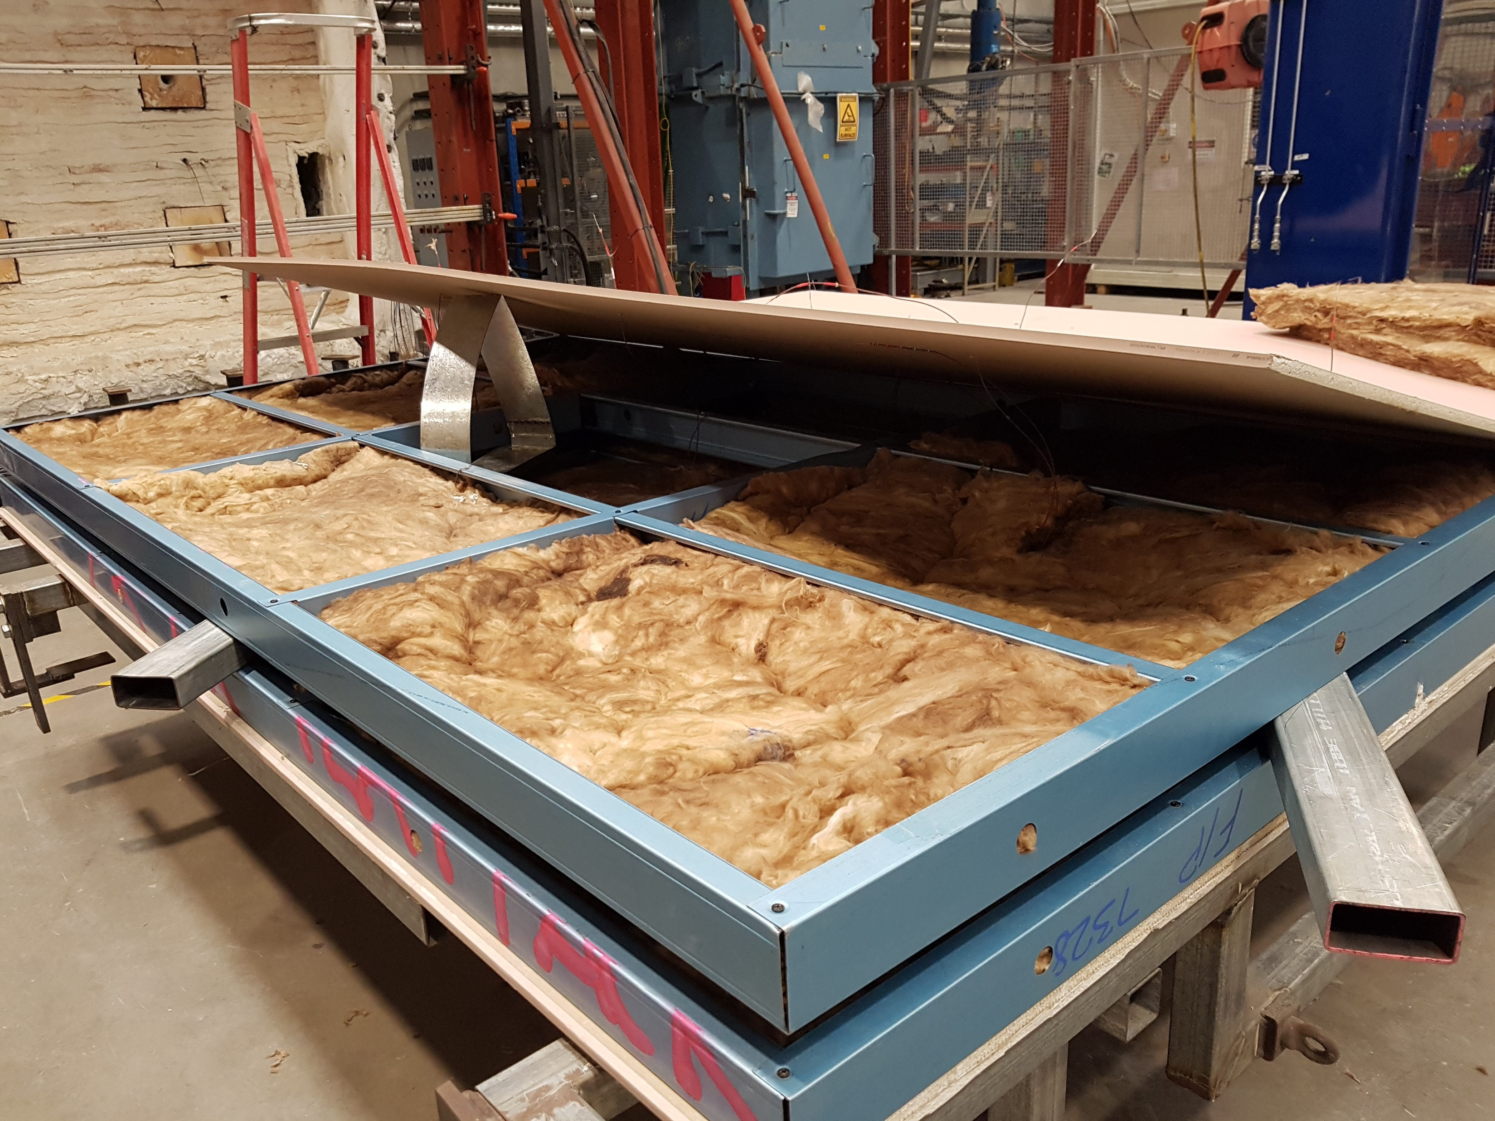
Plasterboard
Glass fiber insulation
Stud row -1
Tracks
Stud row -2
Notes:
T6-construction.pdf

Slide 17
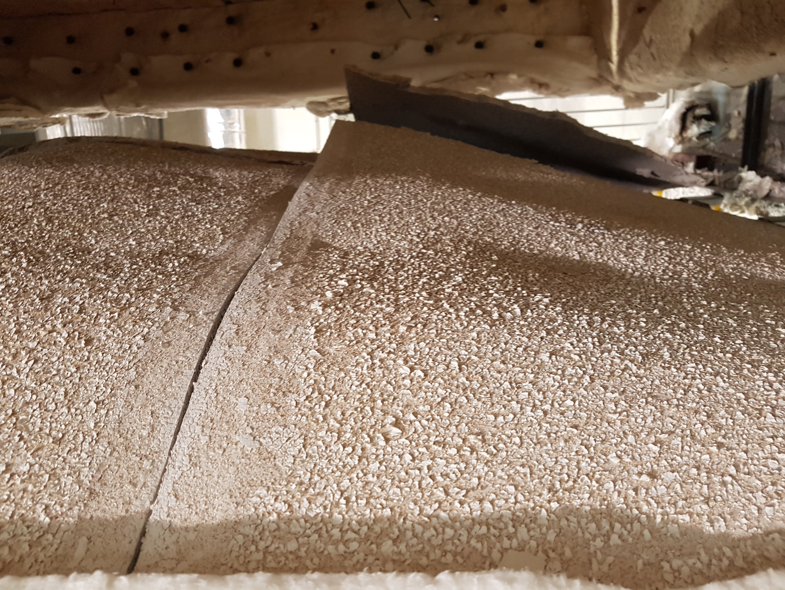
Fire side plasterboard (Pb1)
open-up
Notes:
T5-fireside

Slide 18
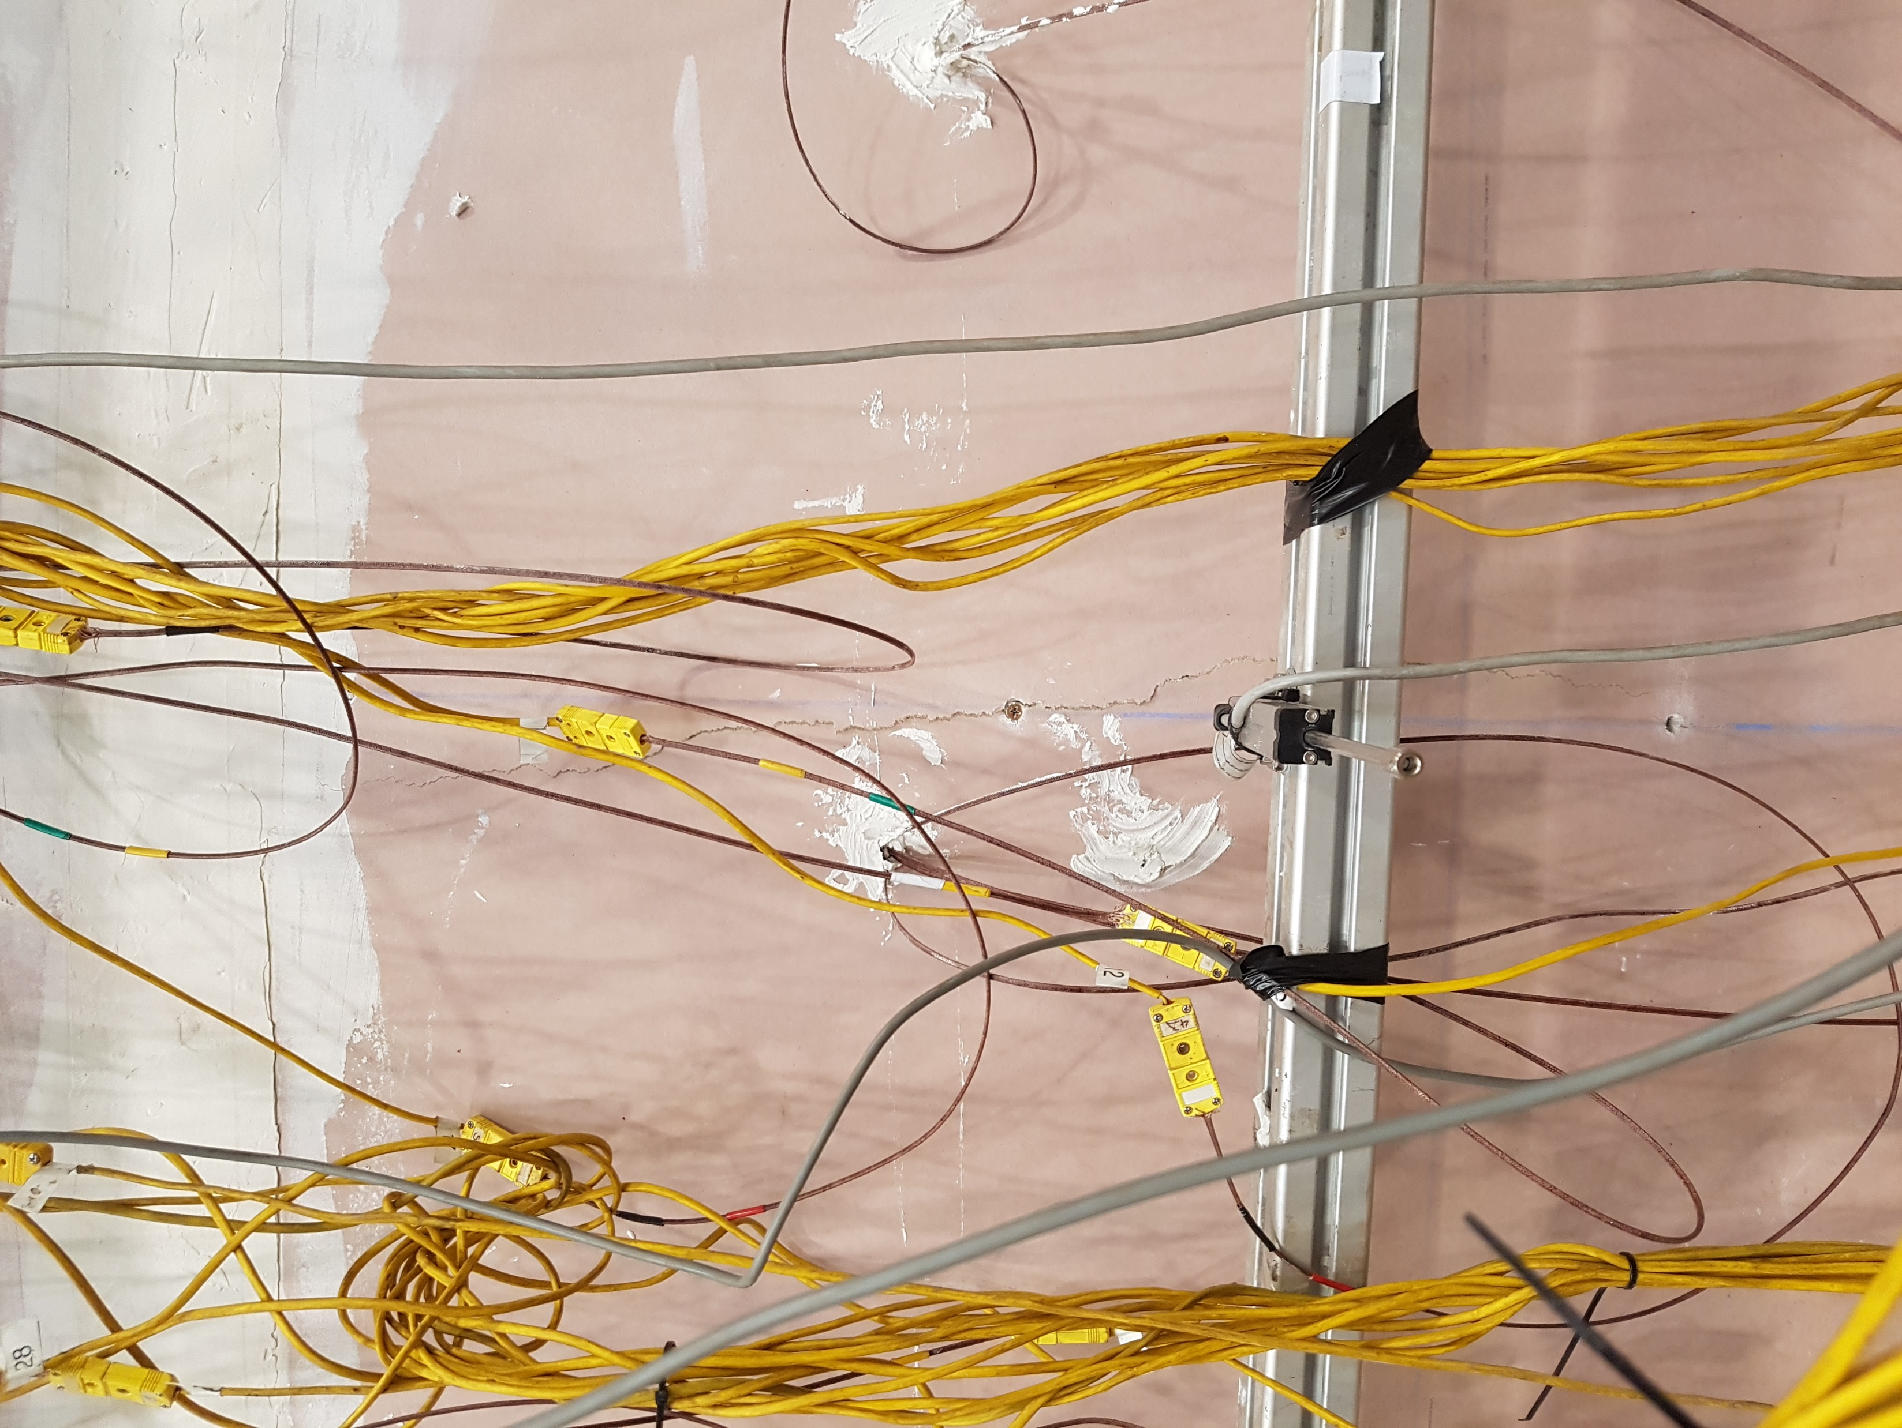
Crack on ambient side plasterboard (Pb4)
Notes:
T5-ambientside

Slide 19
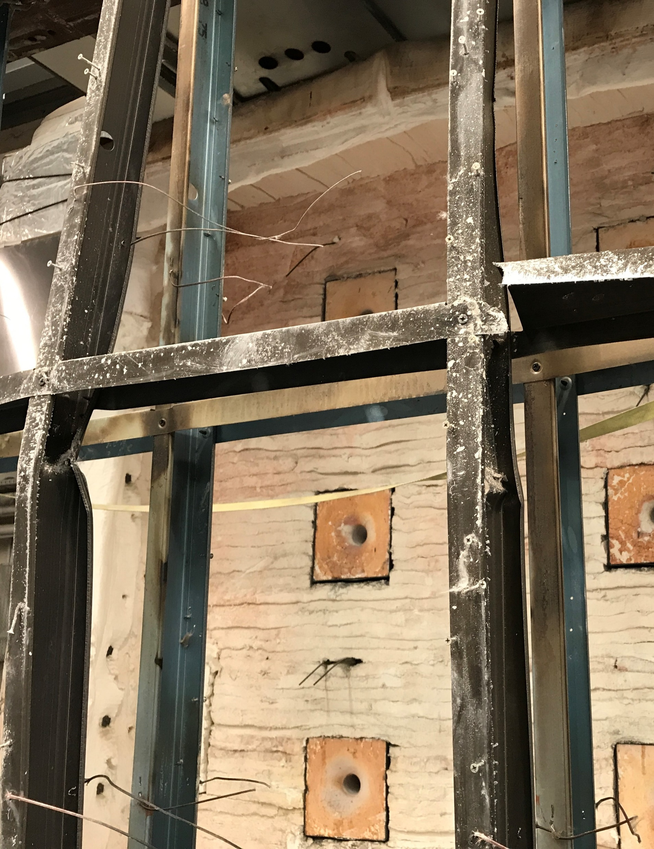
Buckling of Stud4
Buckling of Stud3
Notes:
T5-buckling

Slide 20
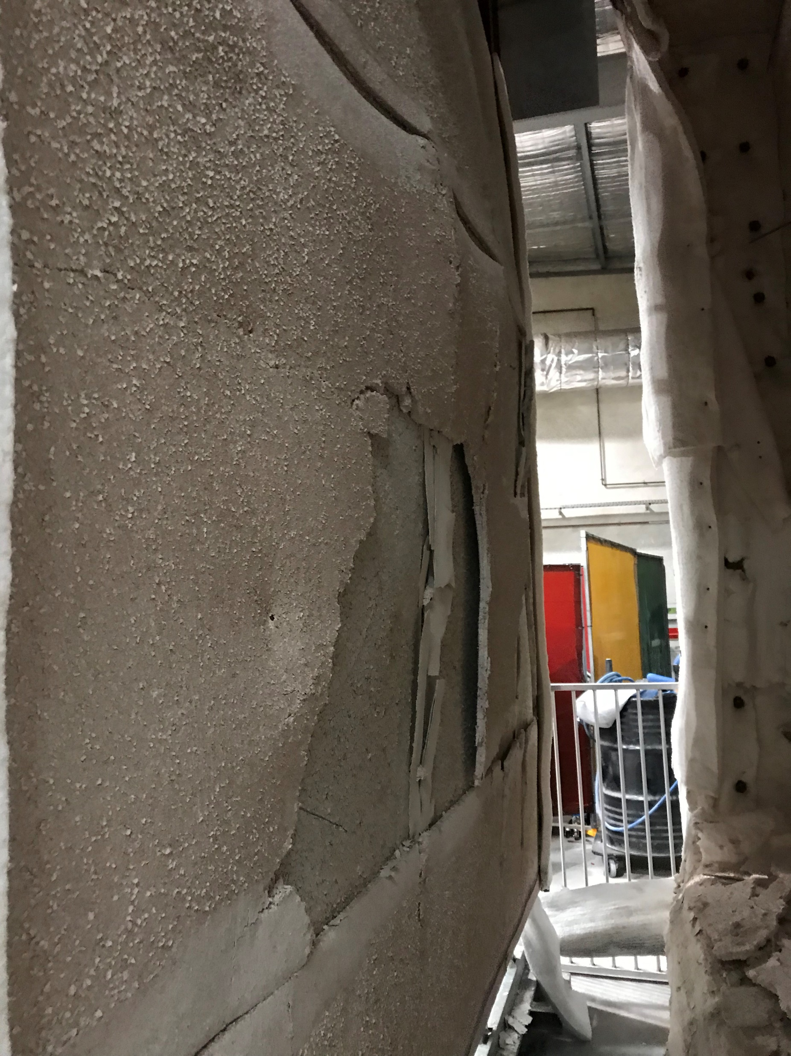
Fire side plasterboard open-up
Plasterboard fall-off
Notes:
T6-fireside

Slide 21
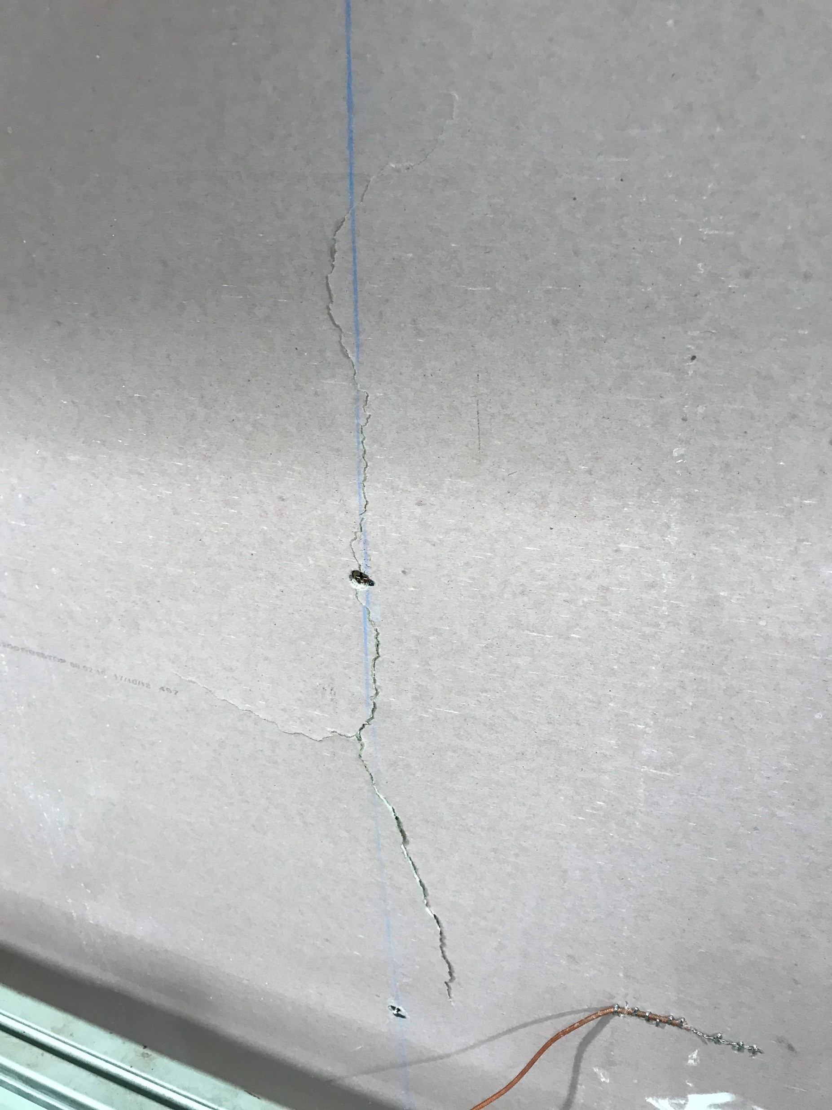
Cracks on ambient side plasterboard (Pb4)
Notes:
T6-ambient_cracks

Slide 22
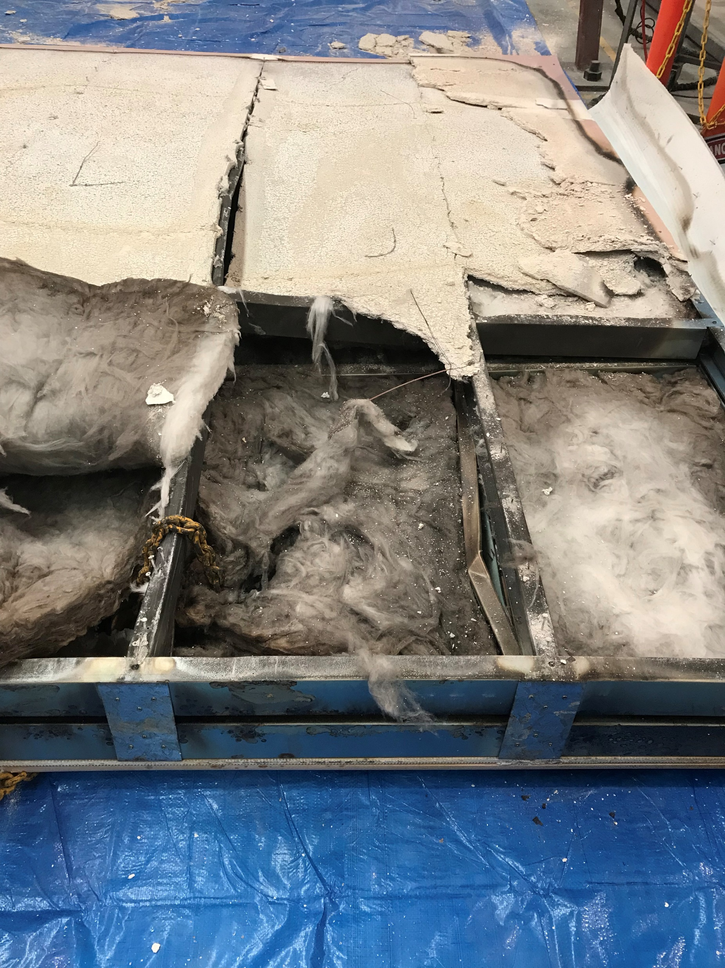
Fire side plasterboard
Discolouration of insulation
Burnt fire side insulation
Intact ambient side insulation
Notes:
T6-fire side

Slide 23
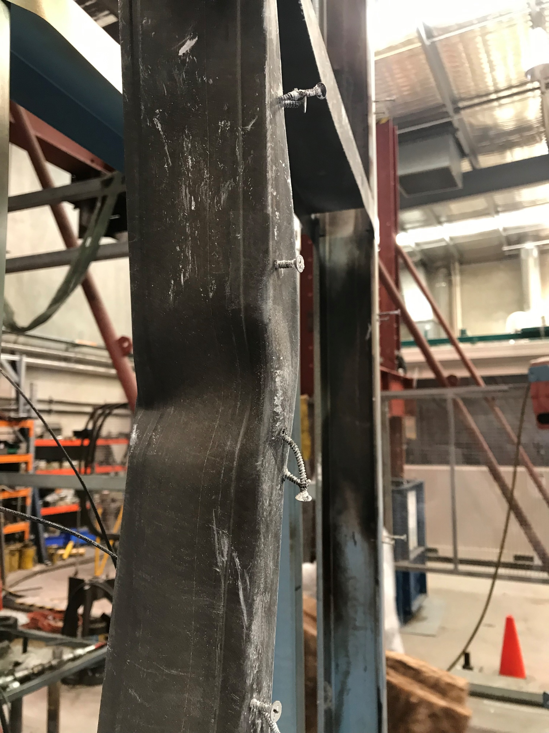
Buckling of fire side stud
Notes:
T6-buckling

Slide 24
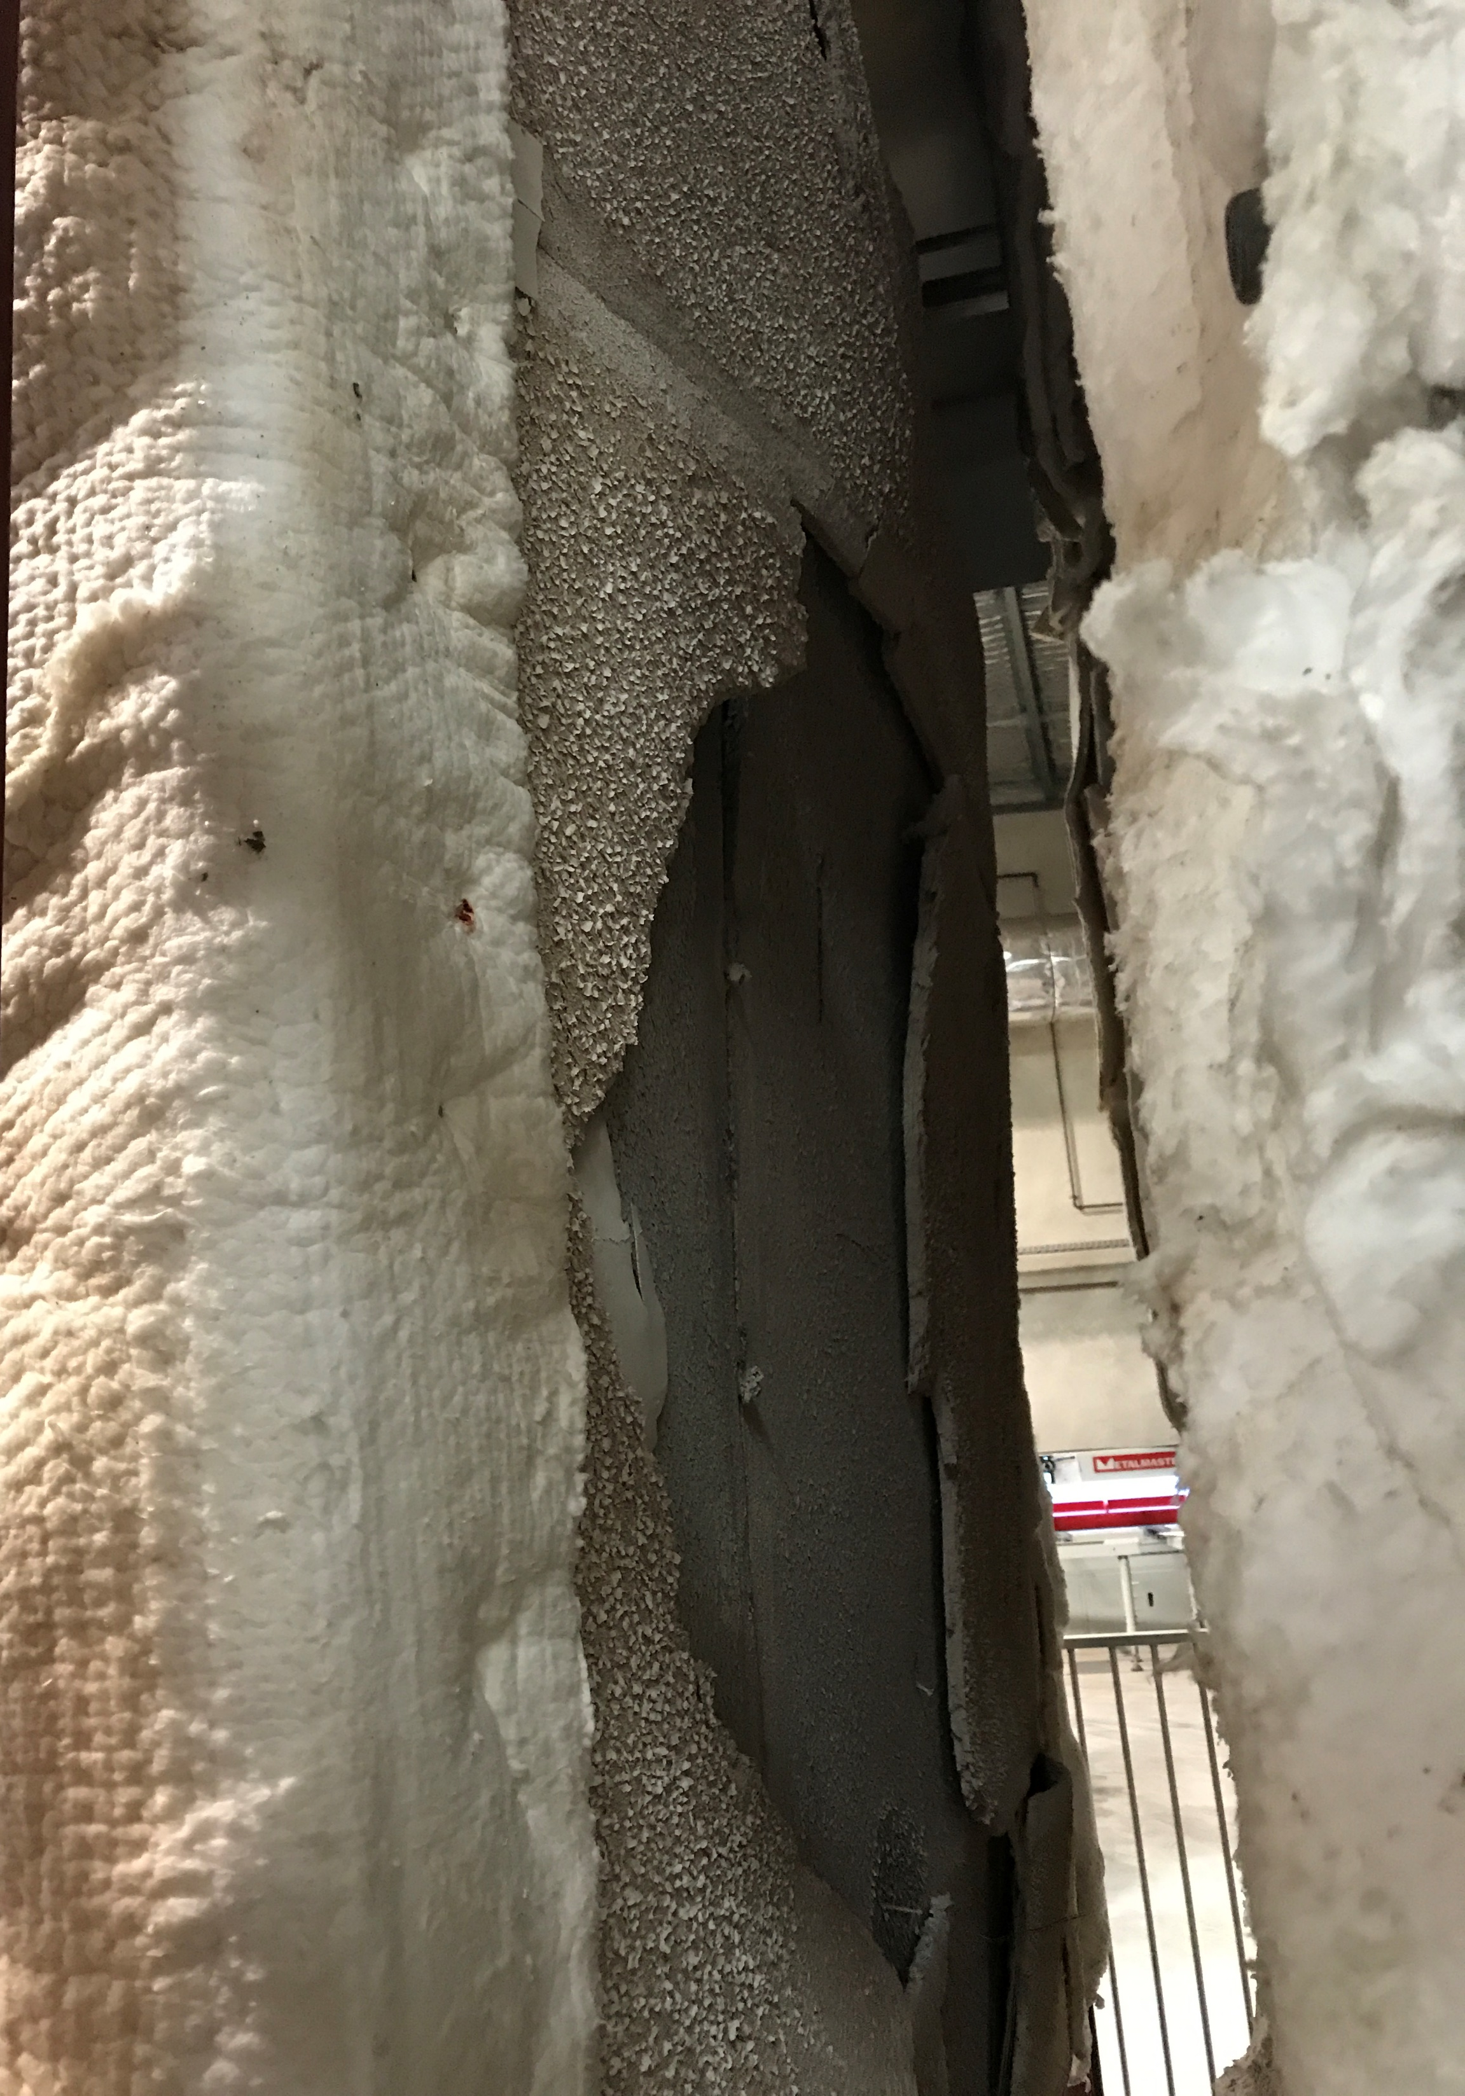
Fire side plasterboard (Pb1)
open-up
Notes:
T7-fireside

Slide 25
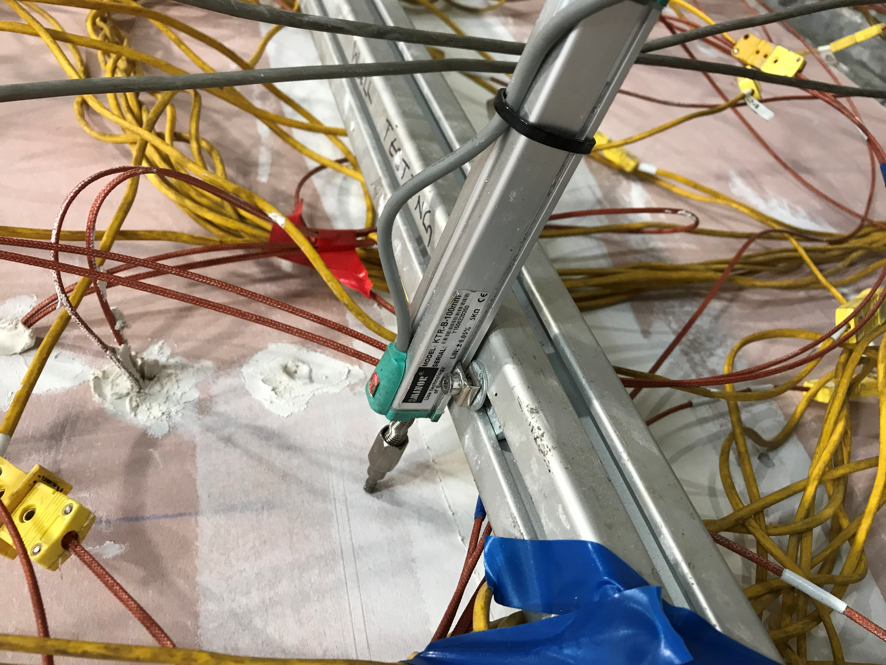
Excessive contraction in LVDT
Excessive bowing on ambient side plasterboard (Pb4)
Notes:
T7-ambientside

Slide 26
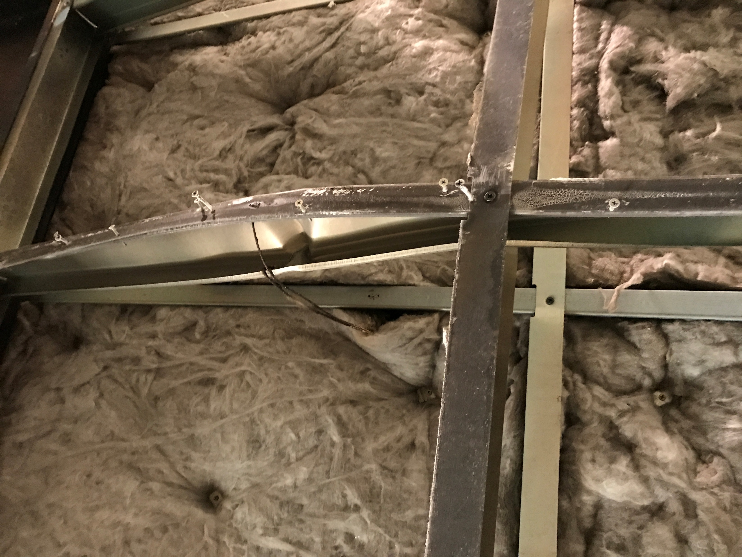
Intact ambient side studs
Intact insulation
Buckled fire side studs
Notes:
T7-buckling

Slide 27
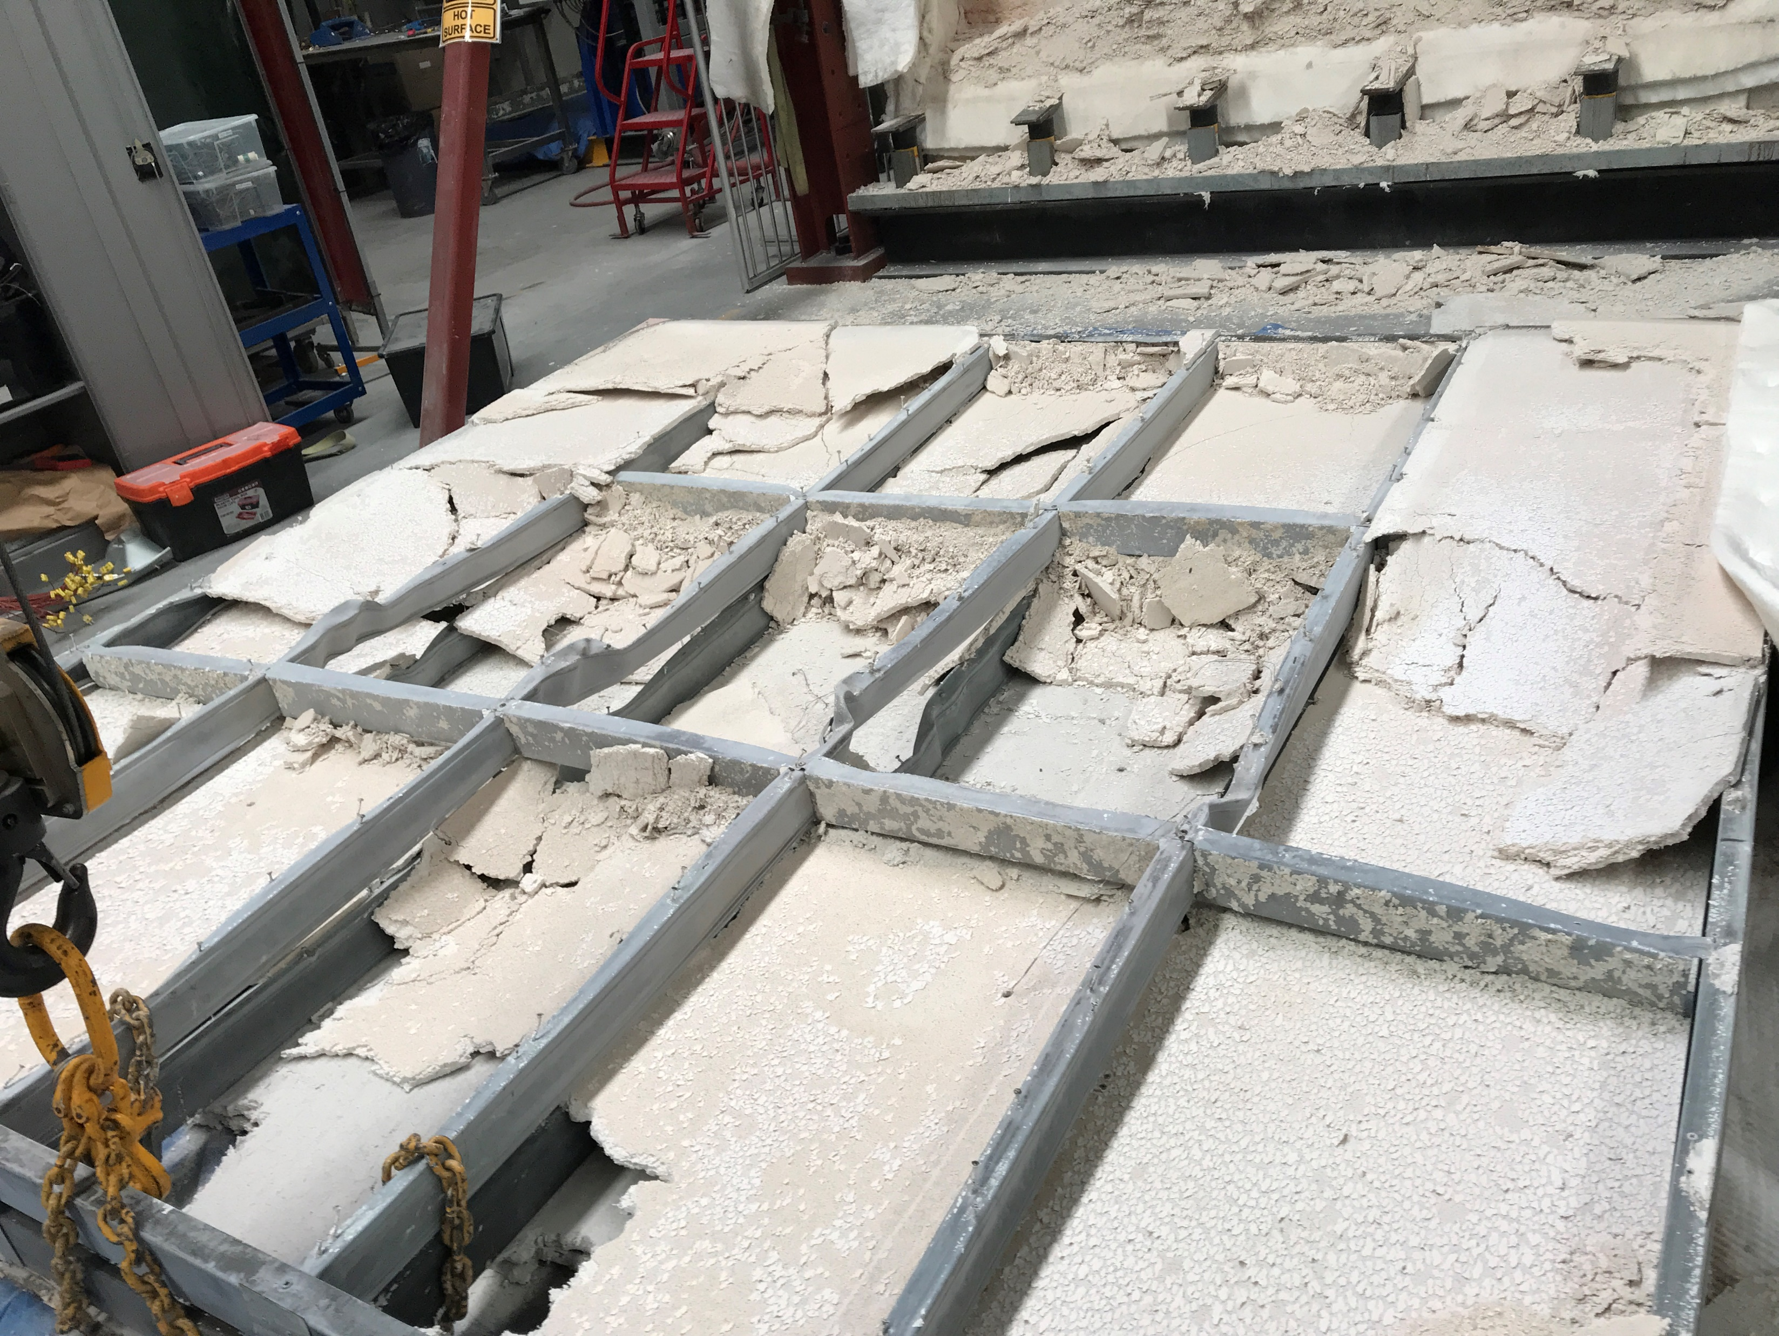
Fully calcinated fire side plasterboard Pb1, Pb2 and Pb3
Intact Pb3
Notes:
T8-fireside

Slide 28
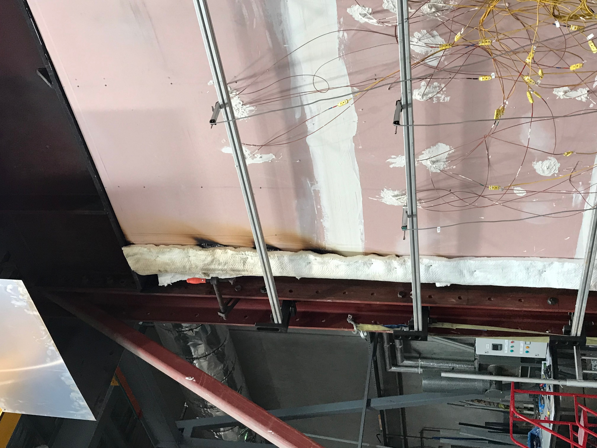
Discolouration of ambient side plasterboard (Pb4)
Notes:
T8-ambientside

Slide 29
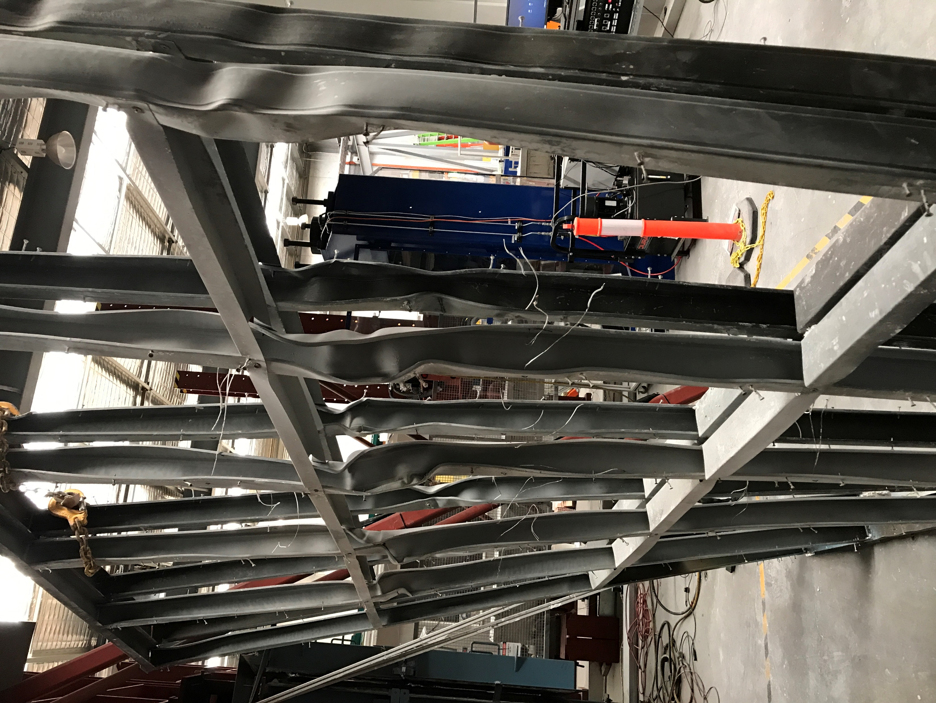
Buckling of all studs
Notes:
T8-buckling

Slide 30
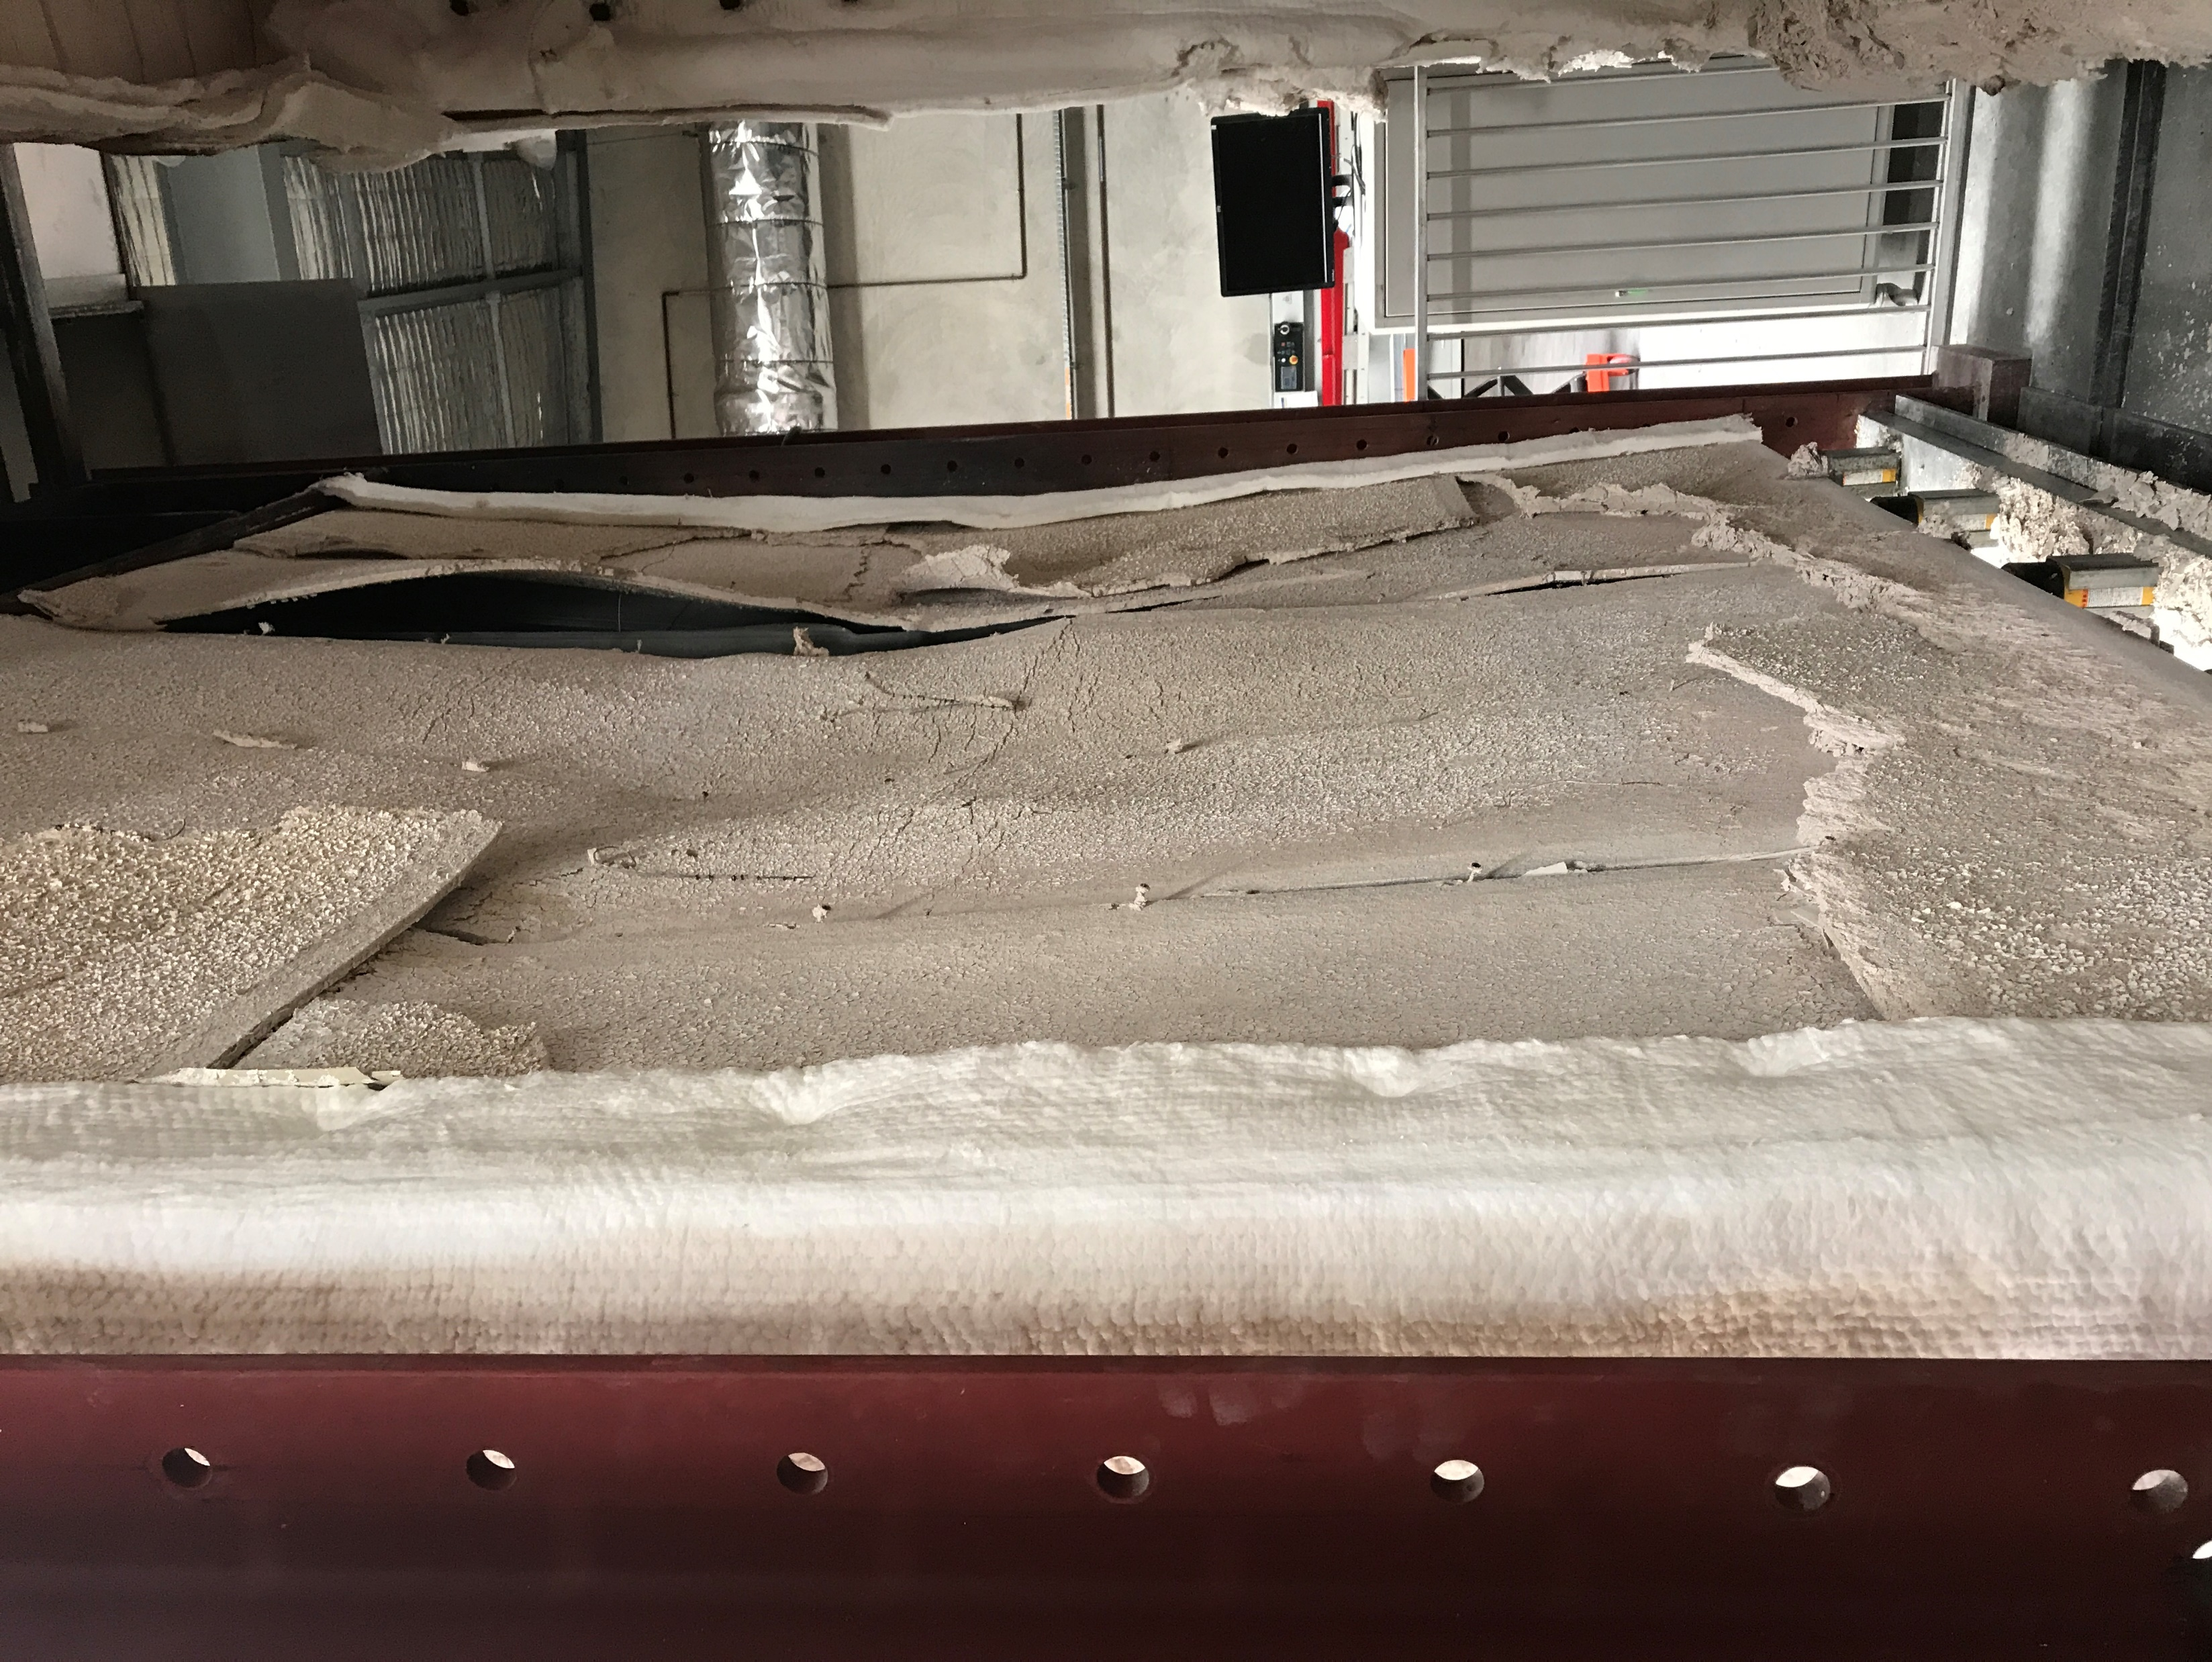
Fire side plasterboard (Pb1) fall off. Excessive thermal bowing
Notes:
T9-fireside

Slide 31
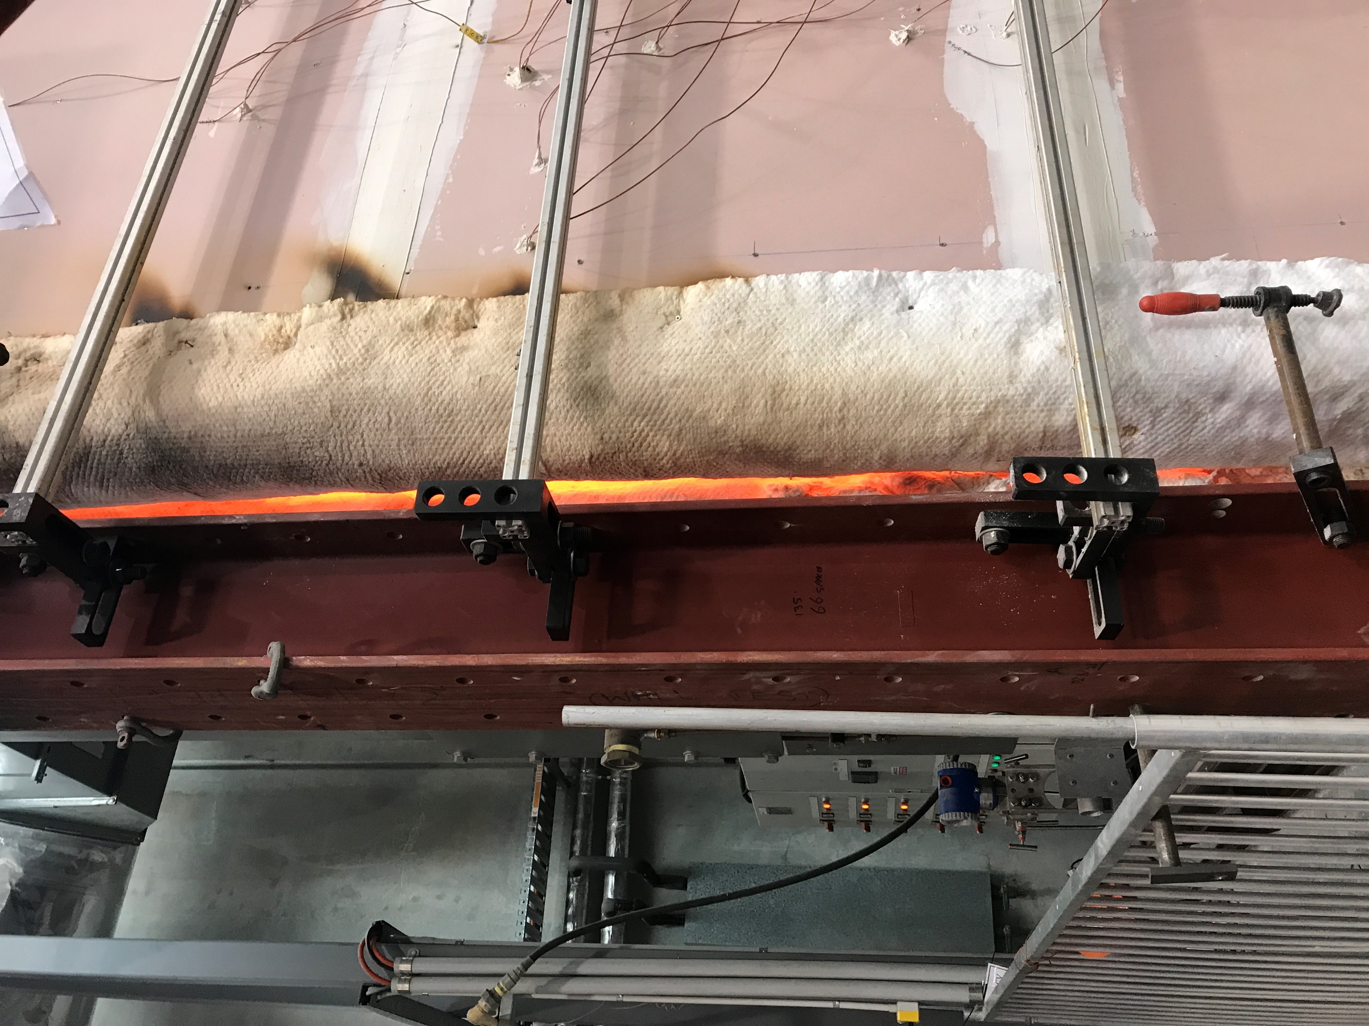
Discolouration of ambient side plasterboard (Pb4)
Excessive thermal bowing and visible flame from burner
Notes:
T9-ambientside

Slide 32
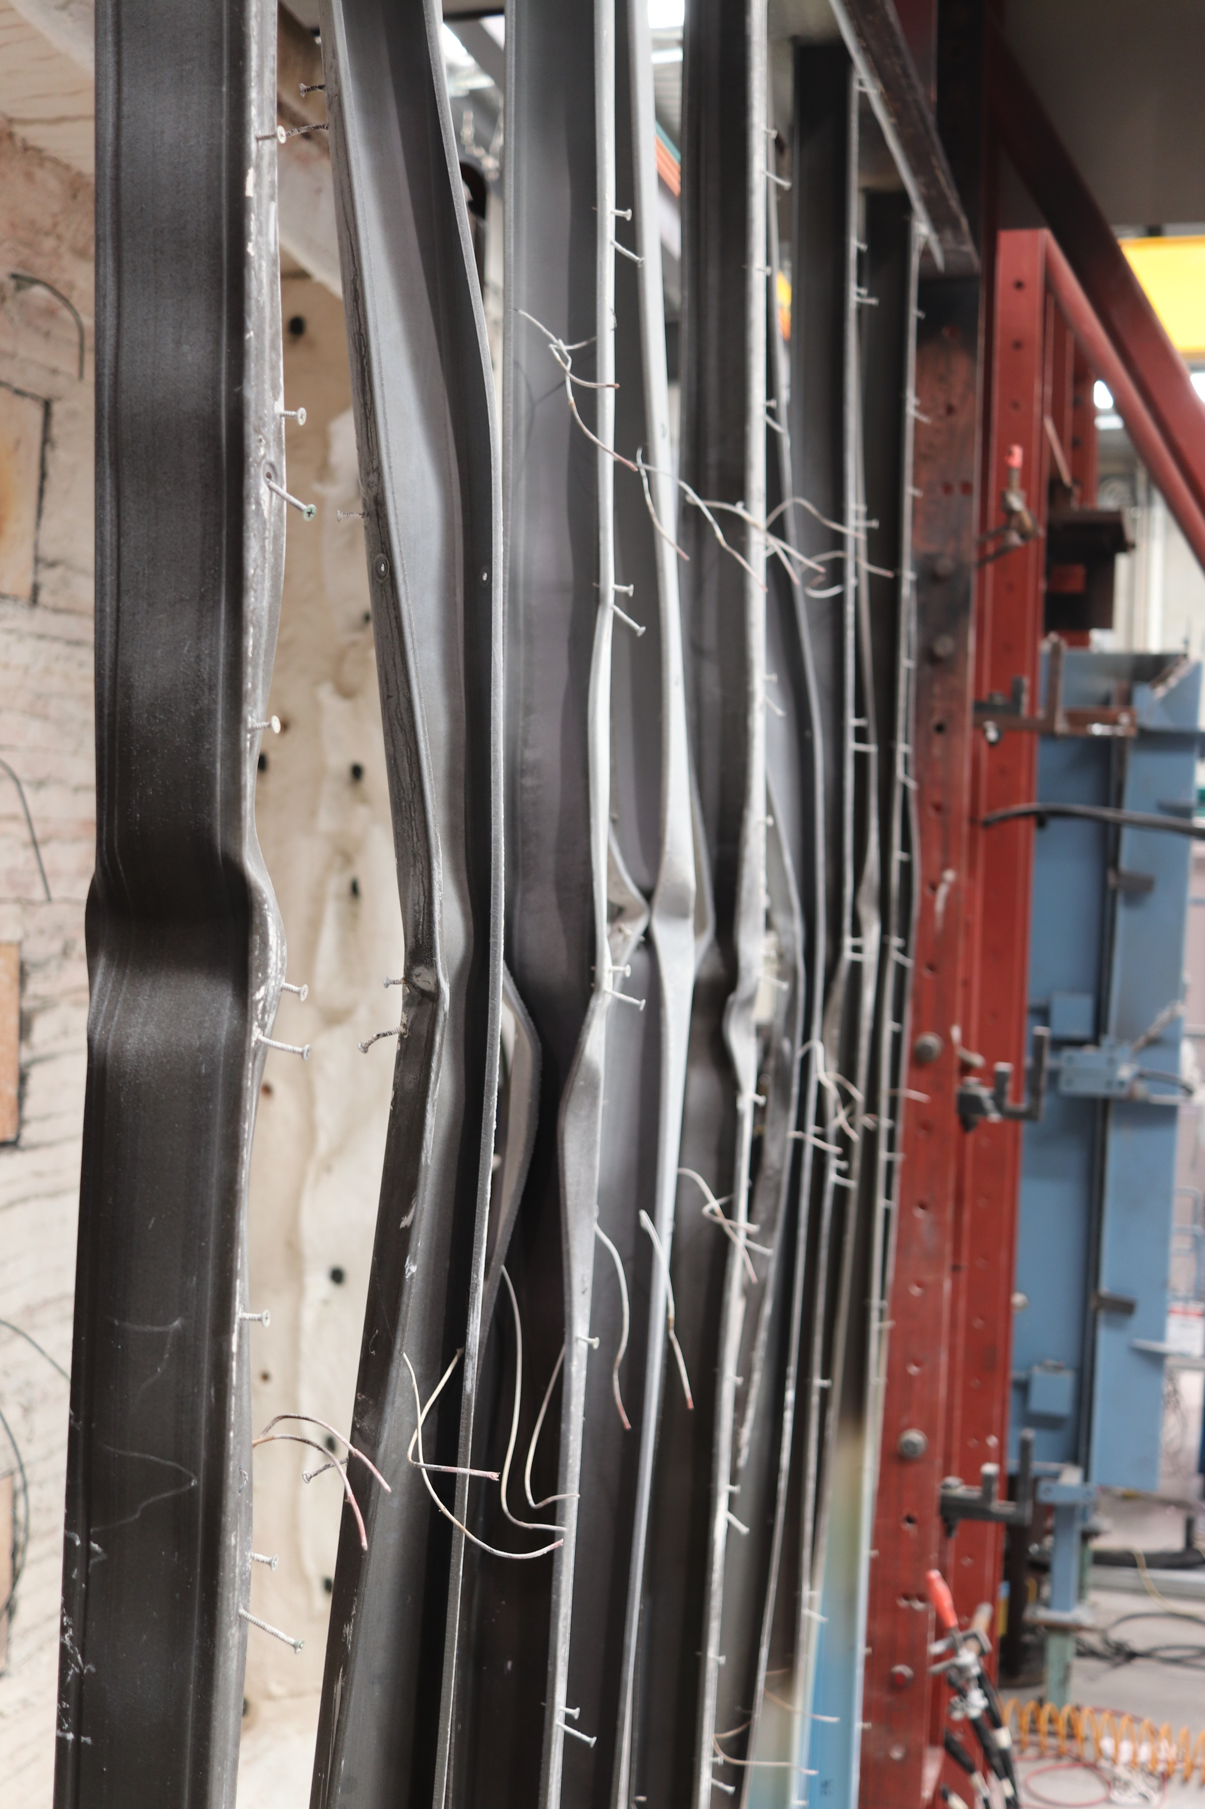
Buckling of all studs
Notes:
T9-buckling

Slide 33
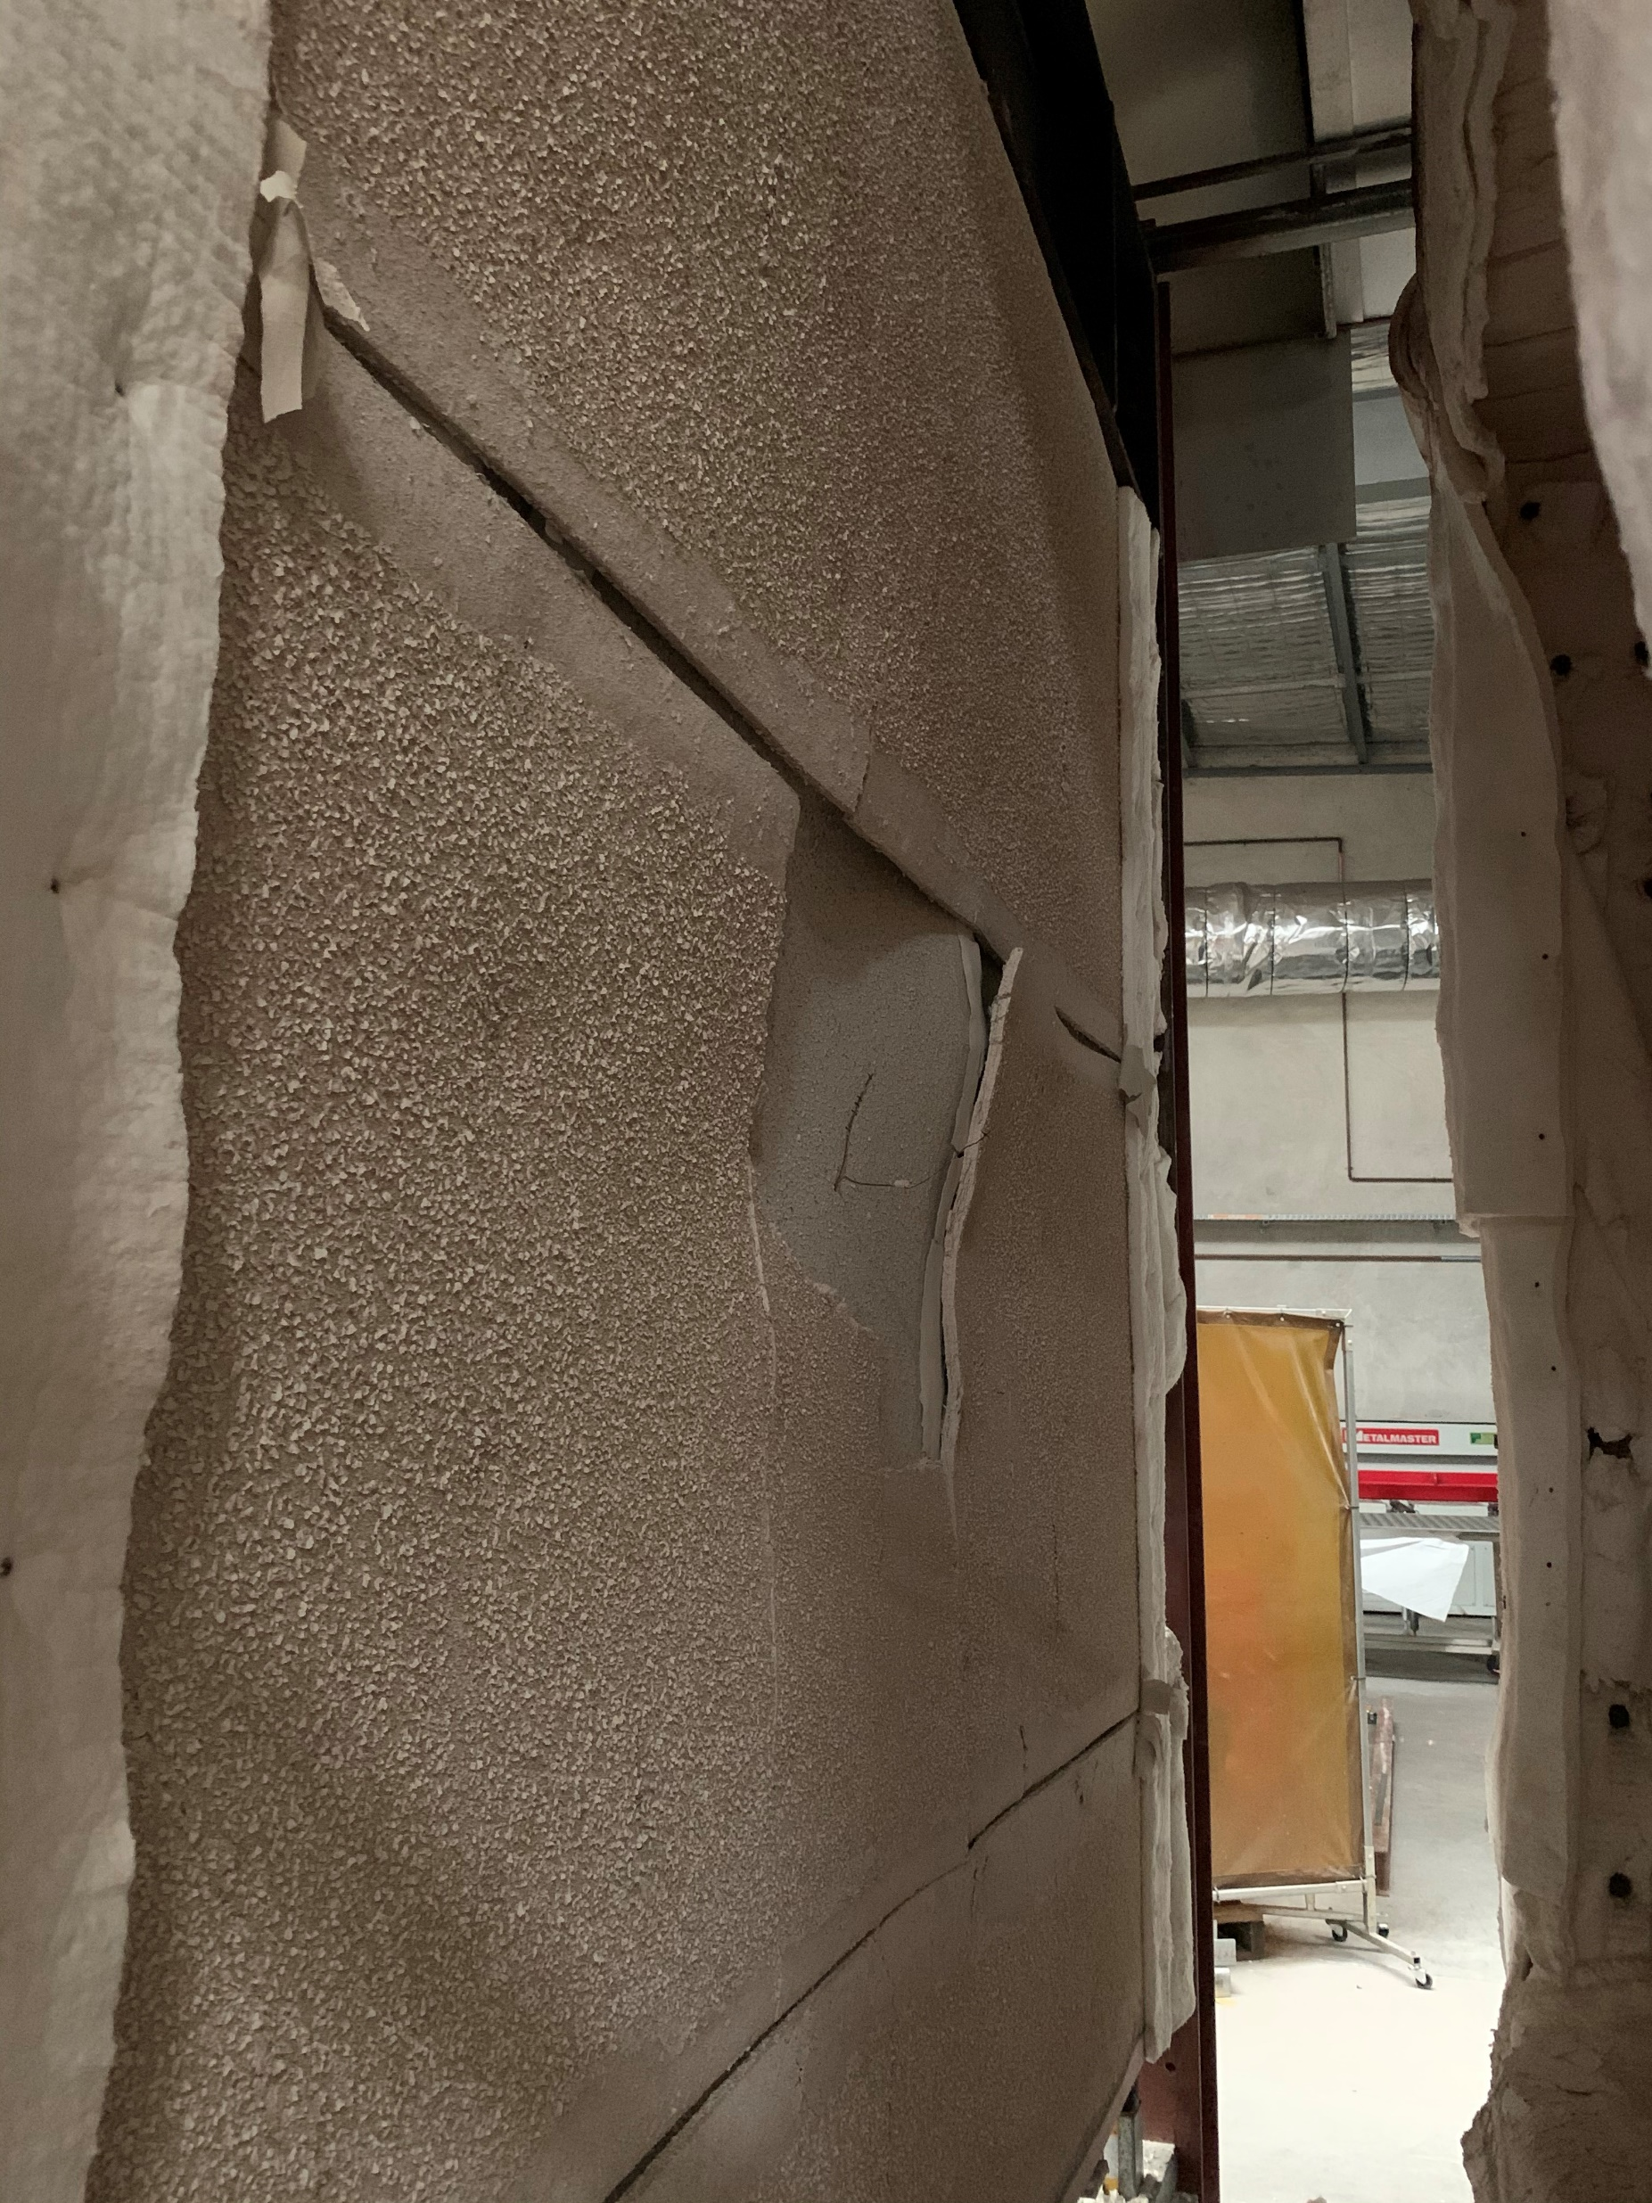
Fire side plasterboard (Pb1)
fall-off
Joint Opening
Notes:
T10-fireside

Slide 34
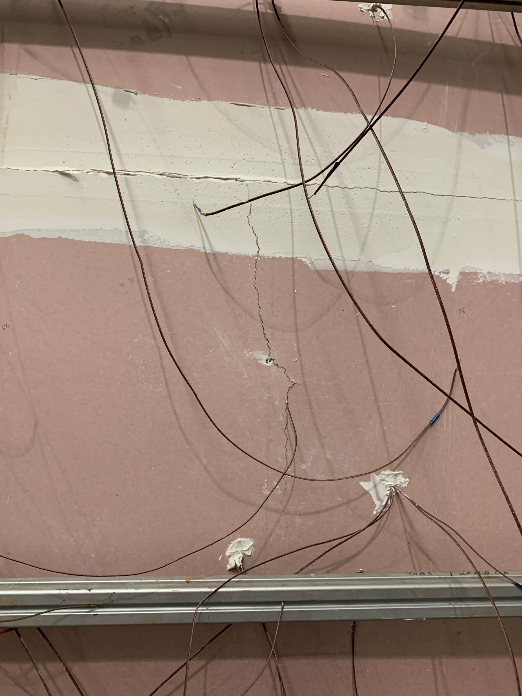
Crack on ambient plasterboard (Pb4) joint
Crack on ambient plasterboard (Pb4)
Notes:
T10-ambientside

Slide 35
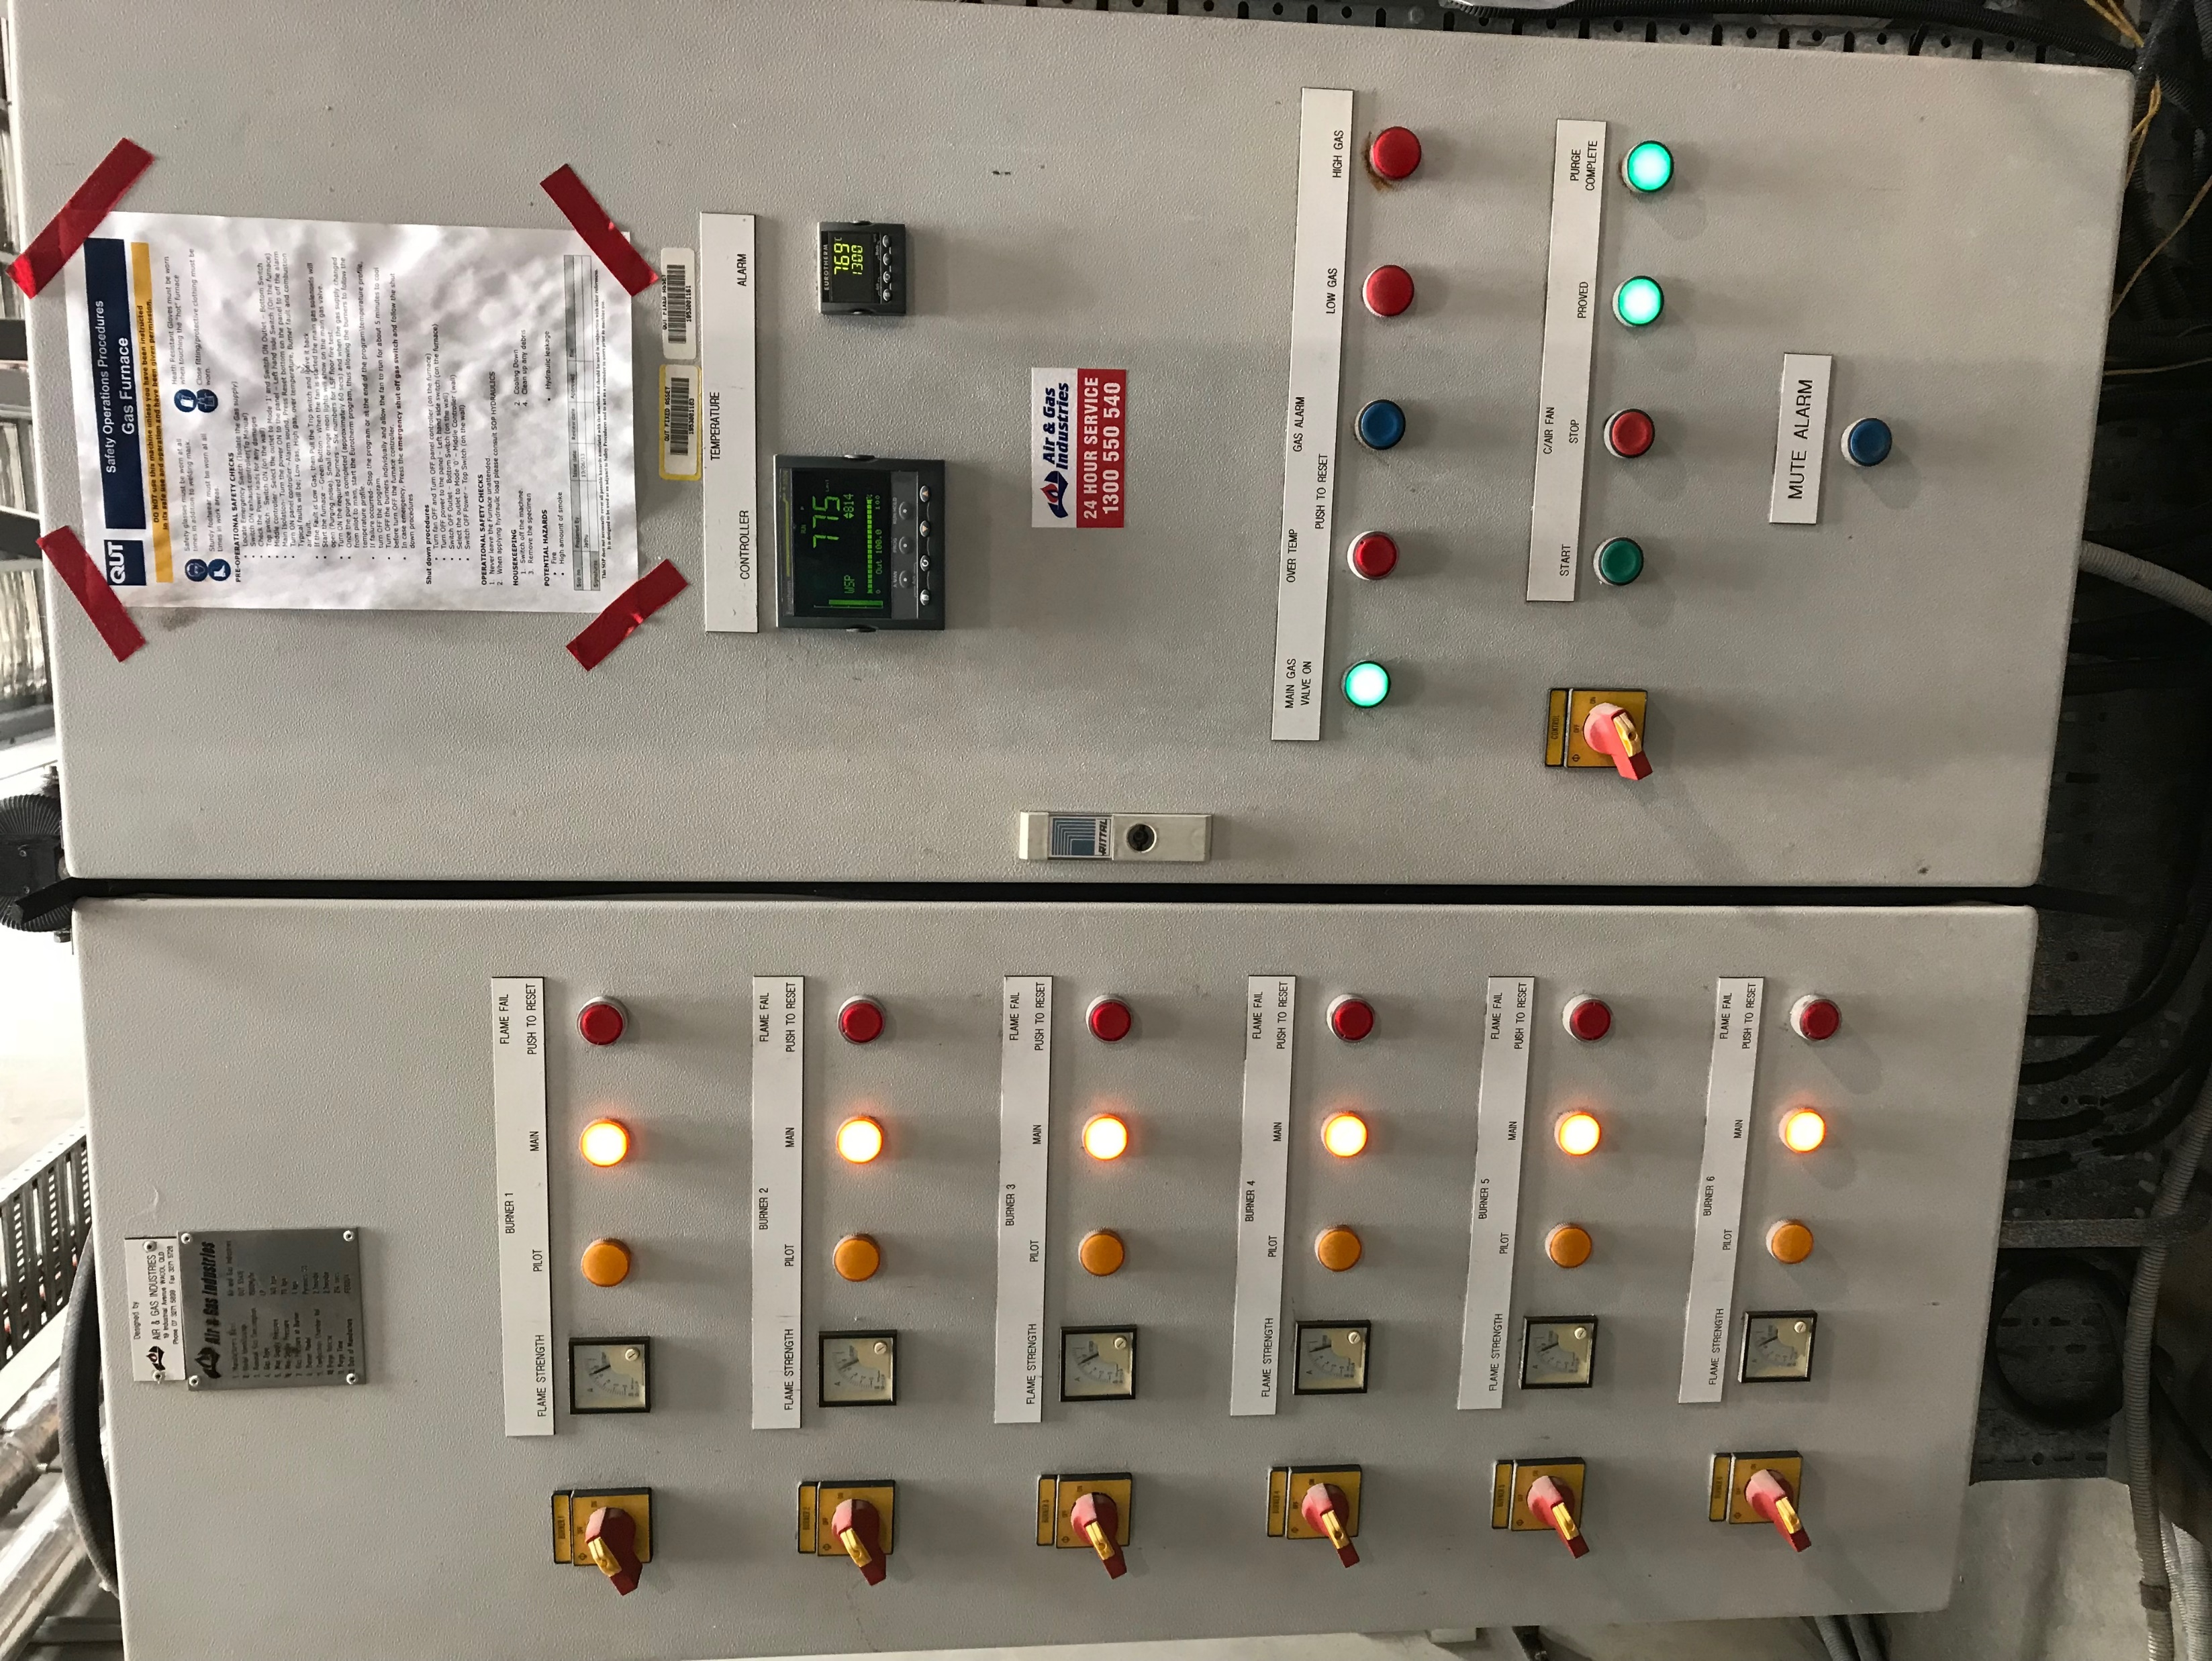
Notes:
Furnace-controller

Slide 36
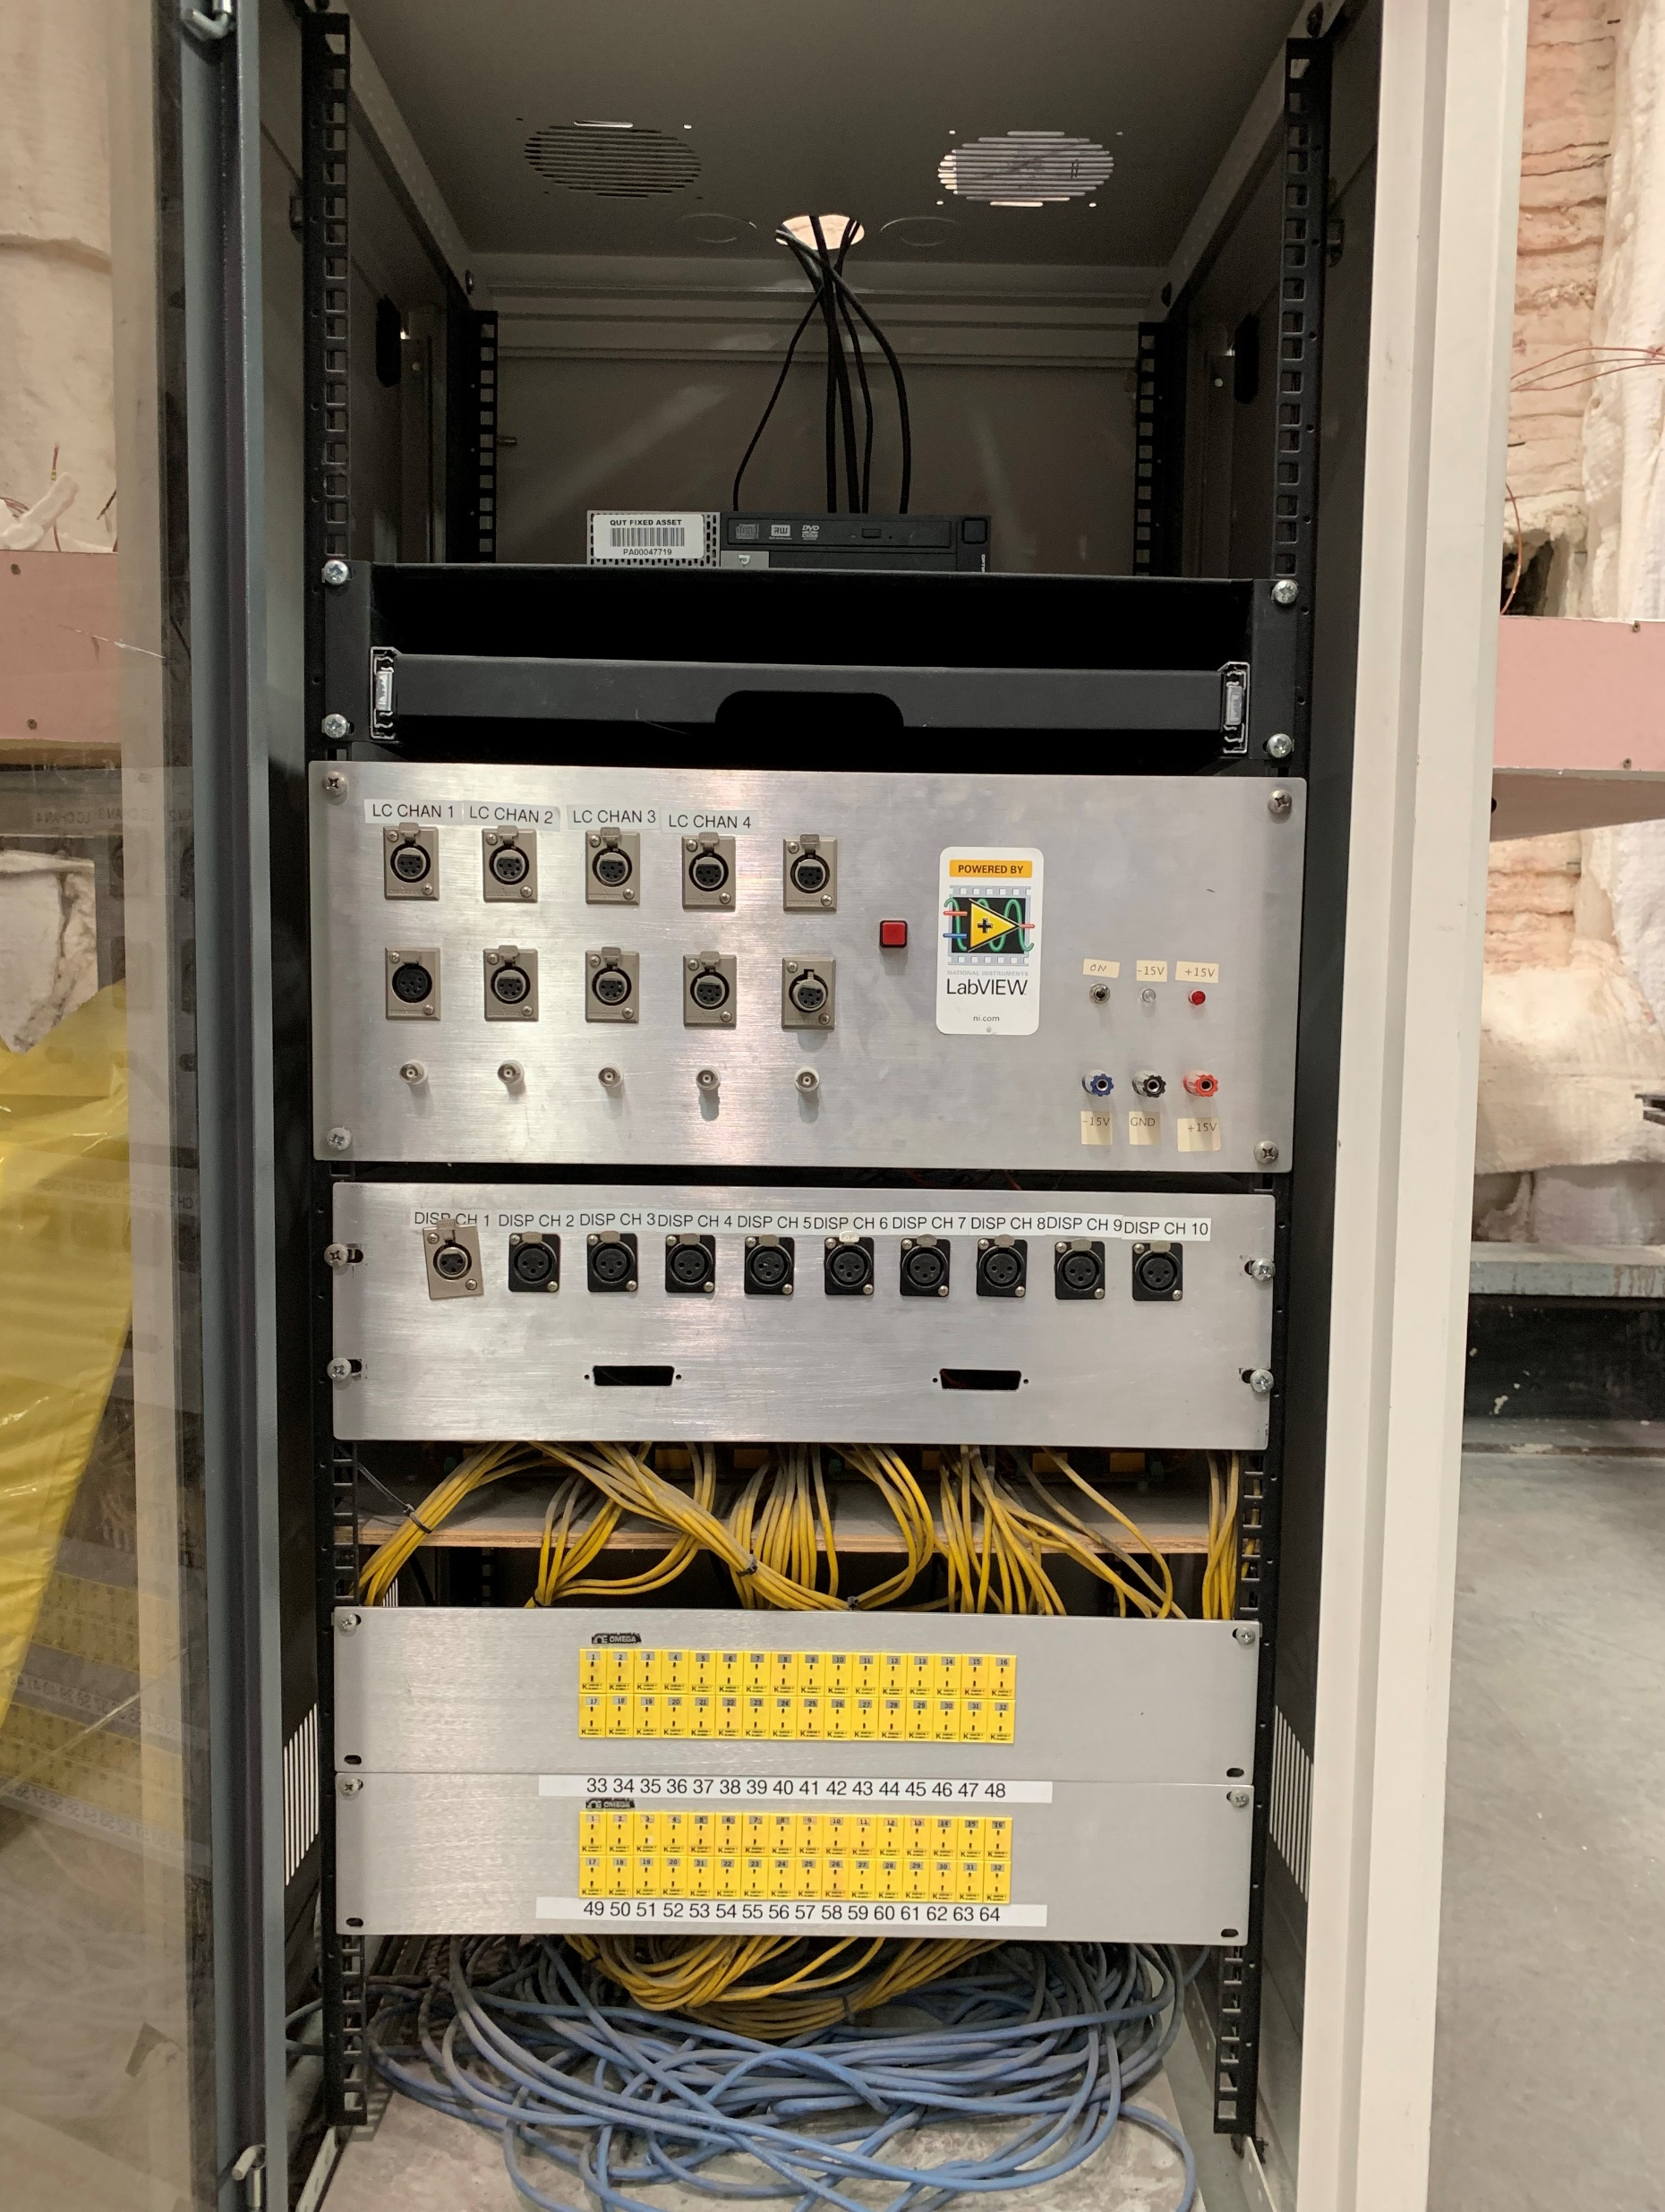

Slide 37
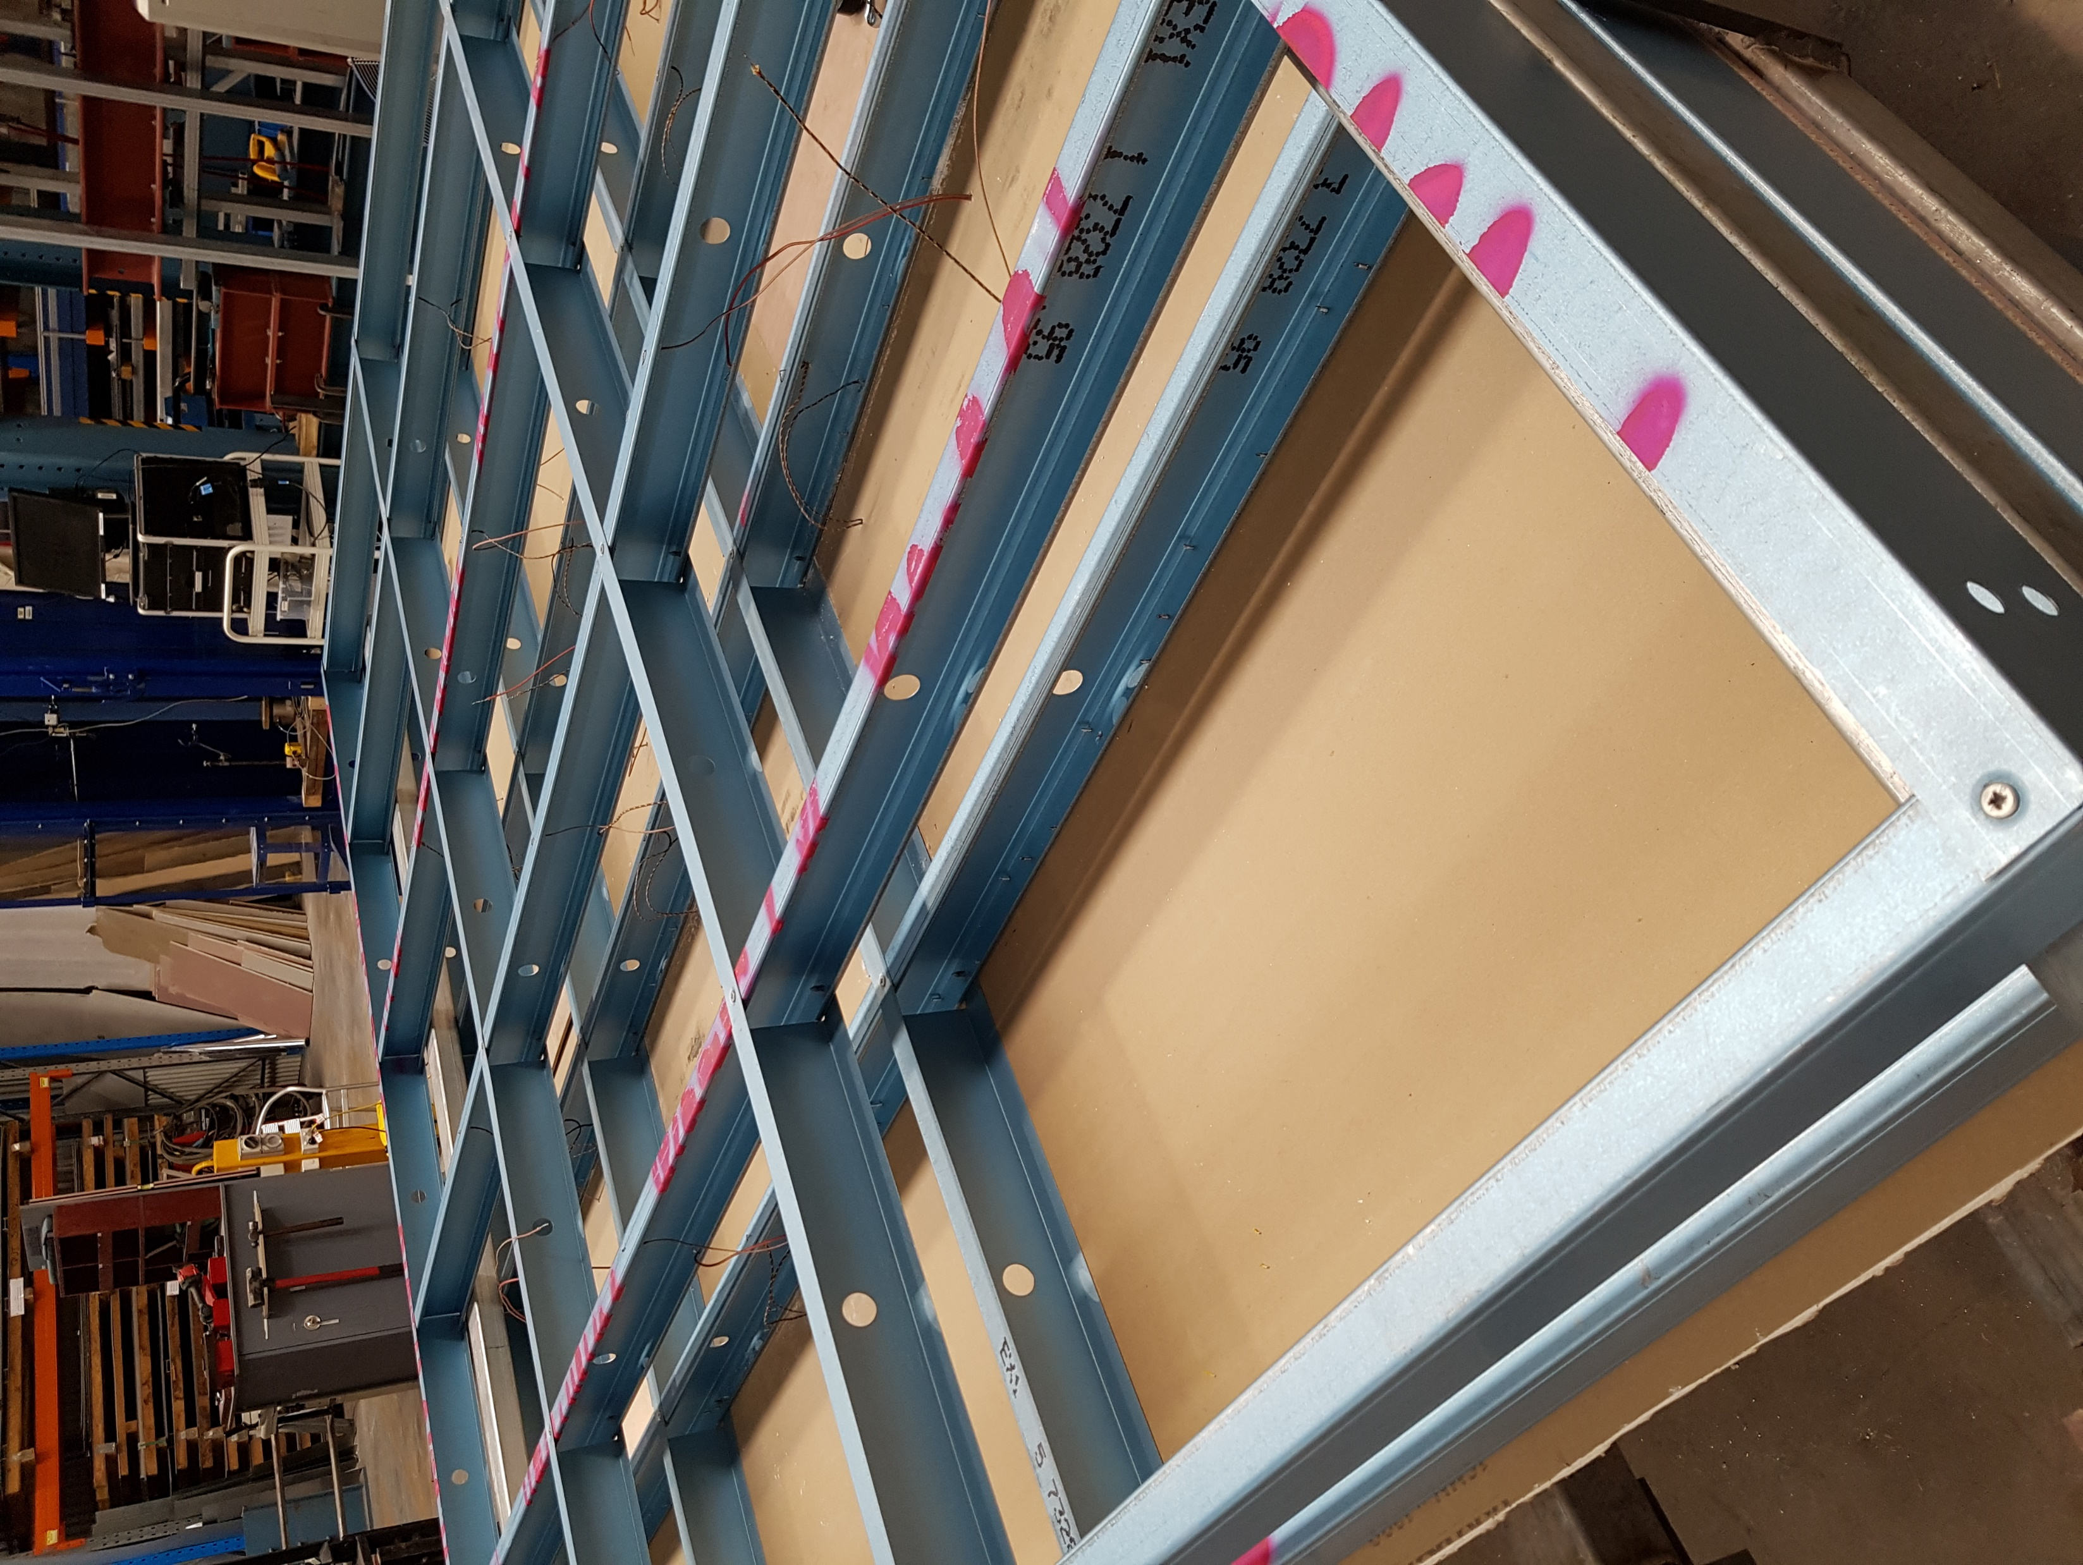
Nogging
Track
Nogging
Studs-Row-1
Studs-Row-2
Plasterboard
Track
Notes:
T1-construction-connection

